Slide 1
Birds and the Bees
Reproductive techniques
Achievement standard 2.5

Slide 2
C.I.D.R’s
A Controlled Internal Drug Release Device is…
A “T” shaped device impregnated with progesterone
It is inserted into the vagina with an insertion device
The two arms that form the top of the T hold the CIDR in the animal
There is a plastic tab that hangs out of the vagina to remove the CIDR
The Progesterone seeps off the device and stops the follicle maturing
A female animal will begin her cycle about 3 days after the device is removed, this is because the sudden lack of progesterone in her system allows the follicle to mature.
This improves production by allowing the farmer to control when the female will begin cycling, this means Aiing will be much more effective and is likely to succeed.

Slide 3
Things that you will need
You will need
CIDR
CIDR applicator
Lube
Disinfectant
Paper towels
Rubber Gloves
A Cow

Slide 4
Application
Disinfect the CIDR applicator by first dipping it in a bucket of disinfectant and then in a bucket of water
Put on rubber gloves, this is because the oestrus in the CIDRs will affect humans
Bend the wings up and insert the CIDR into the applicator, apply a generous amount of lube to the tip
Insert the CIDR into the CIDR applicator with the tag, this is so that the tags don’t irritate the animals tail, if this happens cattle have been known to pull the CIDR out of other cattle with their teeth
Clean the Vulva with a paper- towel
Move the tail and insert the CIDR by pushing it until the CIDR encounters resistance
Press the lever on the CIDR applicator to dispenser the CIDR and withdraw the applicator

Slide 5
What is flushing?
Flushing is the period where animals are given an increased level of feed and an increased quality of feed with the aim of increasing the weight of the animal which in turn increases the amount of eggs that the ewe can produce. Flushing is done for the three weeks leading up to mating. Skinner animals (below BCS 3) will respond the best to flushing while BCS 5 will actually have a higher change of being barren.

Slide 6
Flushing - Step One
3 to 4 weeks prior to mating
Divide the sheep into different mobs, use Body Condition Scoring(BCS) to decide what ewes will require more feeding (BCS <3), or which mobs may require moderate feeding (BCS 4). Some ewes may require less feed if BCS of 5 is found.
Studies have shown that animals will respond best to flushing if their BCS is lower than or equal to 3 animals that have BCS 4 can have slightly increased feeding rates but BCS 5 will be less fertile than lower BCS sheep so less feeding will be required to bring its weight down.

Slide 7
Flushing - Step Two
Have a feeding plan, this can mean that crops like swedes need to be planted the year prior with the purpose of being used as flushing feed. Keep in mind that some crops cannot be used for flushing for example Lucerne when it is flowering because it interferes with the oestrus cycle. Mob A with a BCS of 2-3 needs the best pasture, Mob B with a BCS of 4 needs good feed, Mob C with a BCS of 5 gets less good pasture.
Ideal pastures are around 8 to 10 cm long, when the pasture gets down to around 4 cm the animals should be moved to greener pastures. If there is more than 40% of dead material in pasture ewes will not gain weight because there is not enough nutrients in it and it is just filler. You may need to adjust your stocking rate (stock units per hectare) depending on the amount of feed available.

Slide 8
Flushing - Step Three
Putting the animals onto the appropriate feed to achieve the desired rapid live weight gain.
Give ewes time to adjust to a new feed. If they have a sudden diet change, especially if onto brassica crops like swedes or turnips may cause health problems like bloating. This is because of how a ruminant stomach digests, the microorganisms need time to adjust to process a new feed.
It is important to get a good feeding method to maximise growth and minimise wastage, for example giving sheep small breaks on swedes one a day instead of large breaks every week or using a trough to feed grain instead of spreading it on the ground.

Slide 9
Feeding Overview
It is important to work out how much feed is required to give the target weight while maximising efficiency.
EG a 52 kg ewe that is gaining around 1 kilogram every week will need around 20MJ of energy each day. Here is a helpful chart to determine the amount of energy a ewe will need to reach target weights.
Feeds like hay and straw cannot provide enough energy for ewe’s to gain or even maintain weight regardless of how much you give them.
Live weight gain g/day | Live weight 40 45 50 55 60
100g | 13.5 15.0 16.5 17.0 18.0
150g | 16.0 18.0 20.0 20.5 22.0

Slide 10
Flushing - Step Four

Slide 11
Flushing - Step Five
Leave the mobs on good feed so that they keep good condition during mating. If temperatures drop during 7 weeks after the end of flushing give the ewes a bit more feed because cold shock can kill an embryo up to 4 weeks after conception
Teaser rams may go out sooner during flushing time. This helps stimulate the ewes into going into oestrus, and coming on heat. A teaser ram is a cryptorchid, it has the desire to mate (libido) but with no fertile sperm. This is a result of the scrotum is removed but the testicles are put into the body where it is too hot to produce working sperm. The ewes will respond to potent pheromones that has a very strong scent are excreted into the ram’s wool and begin their oestrus cycling. Almost all of the ewes will produce an egg within a couple of days of the teaser being introduced to the mob.
Keep the teaser ram in the mob for 2 days, after that take the teaser rams out and then put the proper rams into the mob. Before you do this check the rams health eg. Bcs >3, no limping, no footrot.

Slide 12
Flushing – Step five continued
Sheep are photoperiod sensitive. which means that they respond to the length of the day, this means that they can detect if the season is going into winter or summer. Ewes will become most sexually active during the autumn so that their lambs would be born in the spring. And during the winter ewes often wont even cycle and produce eggs.

Slide 13
Flushing - Conclusion
When the animals have gained in weight sufficiently the ovulation rates should have increased. (ewes should produce up to 3 eggs, cows usually 1, and sows up to 20)
Animals should not only been given more feed but higher quality feed as well you may have to give a grain supplement as well
Flushing works the best of animals with a low BCS (3 or lower)

Slide 14
Pregnancy Scanning
What is scanning?
Pregnancy scanning is using an ultrasound scanner to tell if a ewe is pregnant or wet/dry. An ultrasound scanner can also tell how many lambs she is carrying, and if the lambs will come early or late. (scanning also works for other animals like cows)
Usually a contractor will come in and scan the animals for you.
Scanning is usually done within 100 days the ram going out.
This procedure is non intrusive and doesn’t put the animal under much stress.

Slide 15
Scanning – step one
Contact a local scanning operator early, he will be able to tell you much more because he has first hand experience. Make sure you book in quickly because they are often very busy during the time that most people want to scan.
Scanning should be done within 90 to 100 days of the ram going out, during early July. It must be done during this period so that the foetus is large enough to be detected by the scanner. Mark this on your calendar.
The scanner will probably bring a portable crush, screen, the actual scanner, and chalk

Slide 16
Scanning – Step Two
Ewes need to be off grass for at least 12 hours. This is needed because it makes scanning much easier by having less feed in the ewe to get in the way, and so that the ewe can be handled in the yards under less stress.
You will need to provide a set of yards preferably covered so that the scanner and his equipment can be protected, power so that they can run their equipment, and 2 or 3 labour units.

Slide 17
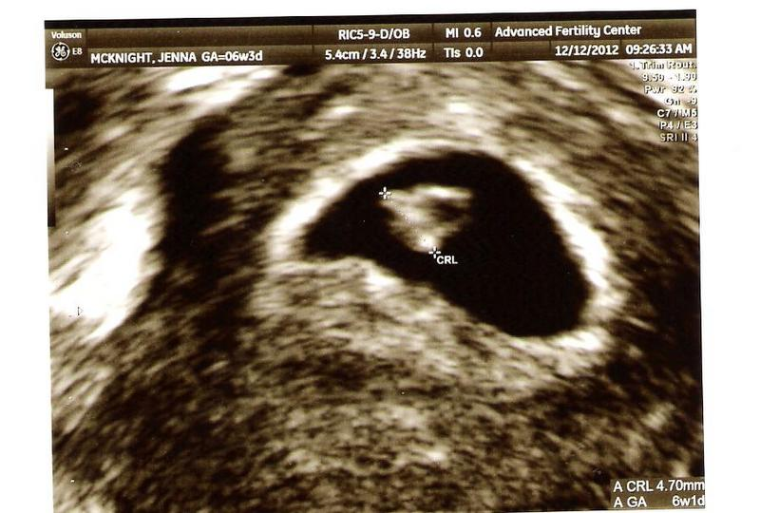
Scanning - Step Three
Help the contractor set up and make sure that everything is prepared before he gets there.
After he has set up you can push the ewes through, the scanning operator will look on a small grey-scale screen while using a hand held ultrasound device on the area of skin between the udder and the hind leg to see if a ewe is wet, dry, has a single, twins, or triplets. It is very difficult to tell the difference and it takes a very trained eye to do so as this picture shows

Slide 18
Scanning – Step four
When the sheep go through the scanning apparatus use chalk to mark them into different groups and then draft them.
You should draft them into different groups so that you can feed the ewes based on how many lambs she is carrying. Singles will need less feed so they can be put on a hill block. Twins and triplets will need more feed because they have more lambs to feed and grow up until weaning where they will no longer have to provide milk. Twins and triplets will also need to be monitored more because they can become cast more easily and are more likely to have birthing problems. More feed is need after the lambs have been born as well because if a ewe feels that she cannot provide for it she will abandon it. It is also best to lamb on blocks that have good shelter because weather is a large factor of lamb mortality rates. A paddock that is good for lambing will have tussock or similar shelter and should be mostly dry so that lambs will find it easier to survive and grow.

Slide 19
Scanning – Summary
Pregnancy Scanning is a very useful tool for farmers because it allows them to provide more feed to ewes that have more lambs and to cull the ones that have none so they don’t have to waste feed and money.

Slide 20
Task 2 - Scenario
Sheep farmer, hill country farm in above average rainfall area and prone to snow wants to review the reproductive technologies on his farm. You recommend scanning.
Consider the number of stock getting pregnant
The genetic potential of the offspring
The effect of time that the ewes give birth
The First technology is flushing
The Second technology is scanning

Slide 21
Letter
To Simon Engelbrecht, rolling hill country farmer, on your commercial sheep farm with good rainfall but prone to snow. Two reproductive technologies that could increase the precision of timing, increase genetic potential, increase yield and the end goal of increasing profitability, these two technologies are scanning and flushing.
I recommend flushing as one of your reproductive technologies because it will increase your profits. Profits are increased by higher yields and little increased costs. Flushing ewes increases the ovulation rate and therefore the potential to have more lambs and larger lambs. This is done by increasing the feeding rate for the three weeks prior to mating. As the ewe begins to gain condition she is much better able to carry lambs and is more likely to begin her oestrus cycle and when she does there are likely to be more eggs per cycle meaning she is more likely to have twins or triplets. Because the farm has above average rainfall the farmer should b able to provide enough feed for flushing to be economically viable. Flushing will make the farmer more money because he will have more lambs and heavier lambs to sell.

Slide 22
Letter – Part 2
I also recommend pregnancy scanning for a reproductive technology that will benefit the profitability of your farm. Pregnancy scanning will increase profits by increasing the amount of lambs that ewes produce and the weight of the lambs that they produce. Scanning your ewes will tell you how many if any lambs that they are carrying, once you know what the ewes have for example triplets you will be able to feed them more so that they will have larger lambs at birth and be in better condition so the ewes can feed them more milk. Because the farm is prone to cold weather (snow) the farmer will be able to put the ewes carrying more lambs on lower, warmer, higher quality pasture where the farmer will be able to monitor them more and the singles on higher country where the feed may not be so good and there may be snow because the ewes will be able to handle it better. During lambing the ewes that are having multiples should be put on more sheltered, dry ground where the farmer will be able to monitor them more easily and the singles can be put on less accessible blocks. To improve the genetic potential of the mob the farmer may choose to only breed next season with ewes that scanned with multiples, this will over time increase the breeding worth (BW) of the flock and eventually no ewes will scan with less than 2 lambs.

