Slide 1
The “Middle ages”
c. 500 AD. -------1500AD.
1300—1500 Early Renaissance

Slide 2
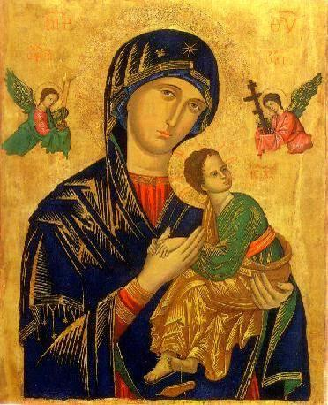
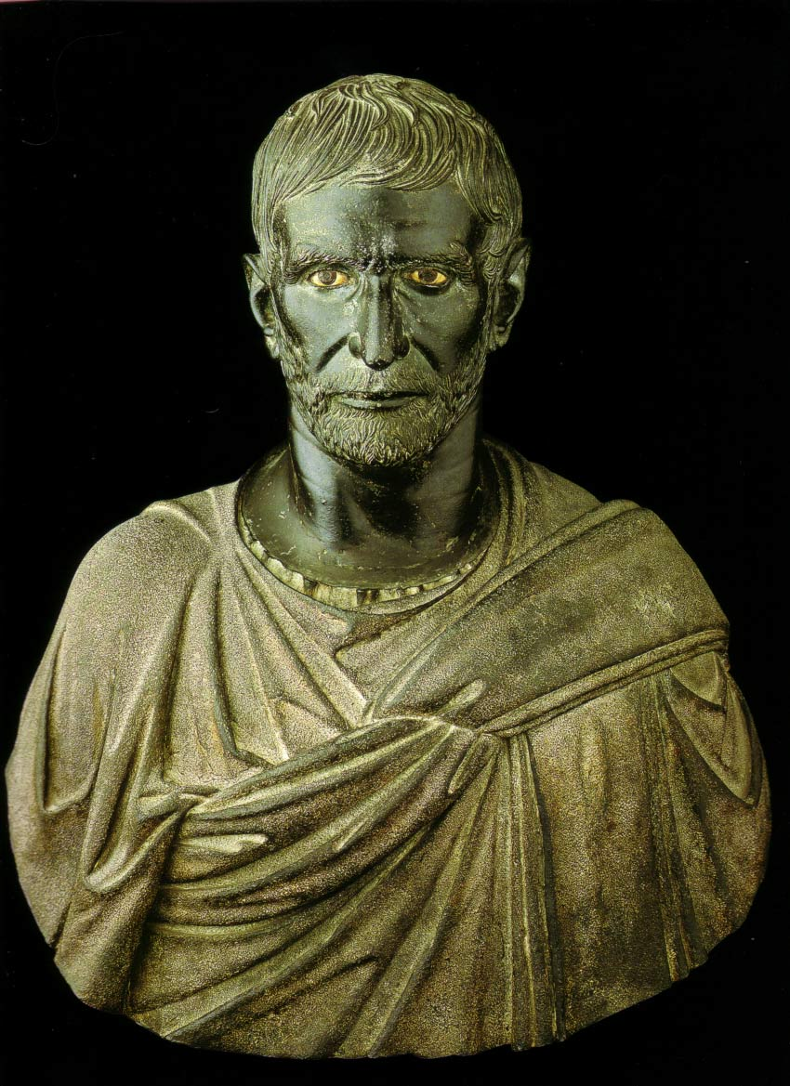
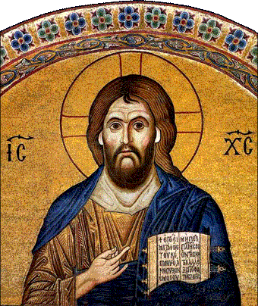
Comparing the change Roman/Byzantine
500AD ------1300+ AD

Slide 3
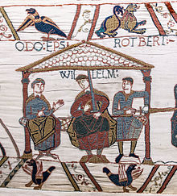

Slide 4
Architecture…

Slide 5
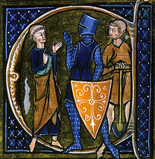

Slide 6
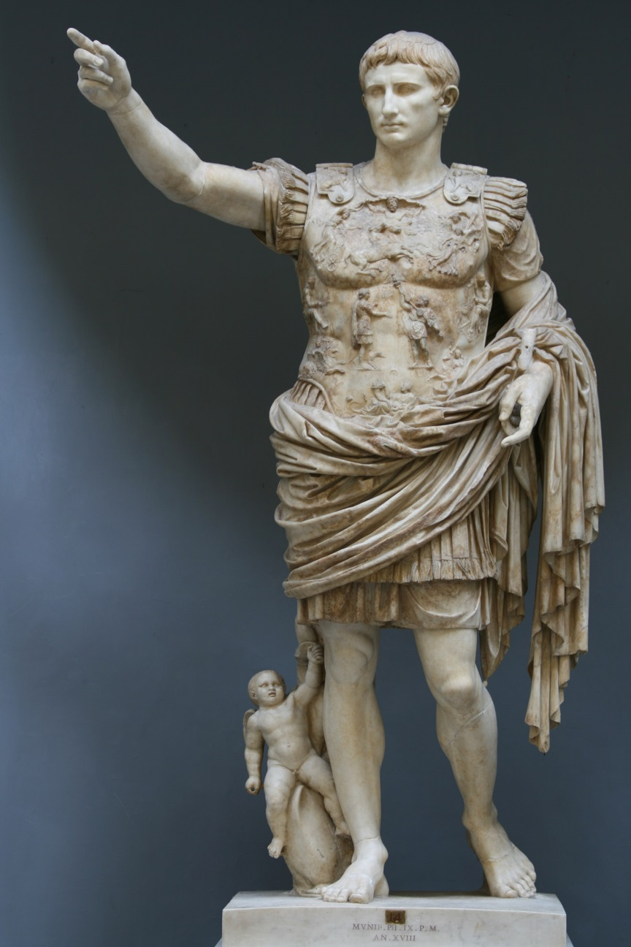
Compare and contrast…

Slide 7
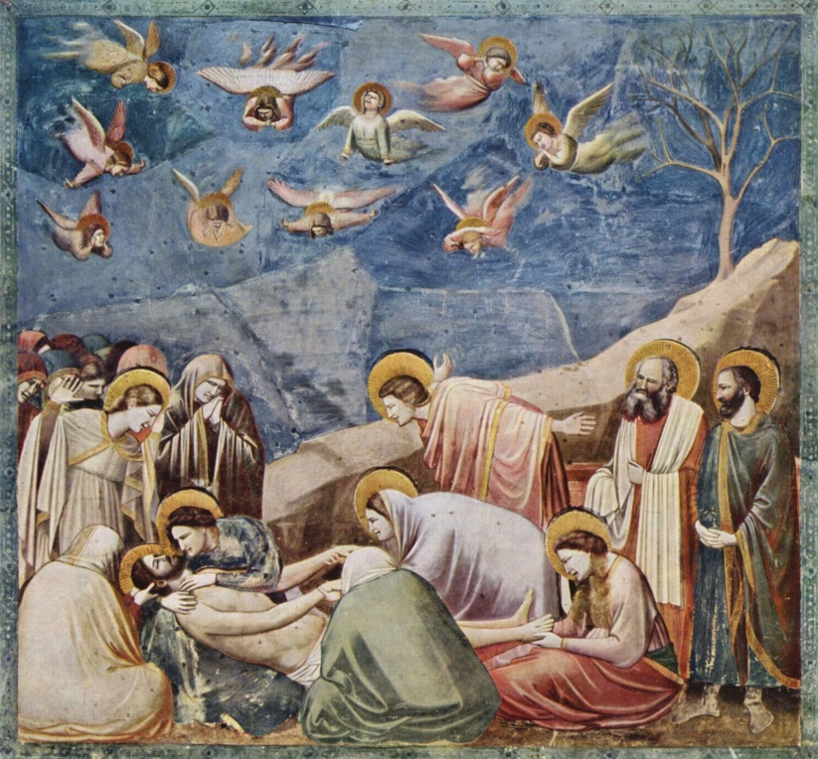
Giotto di Bondone

Slide 8
Compare and Contrast..

