Slide 1
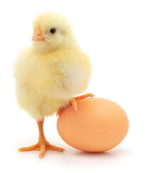
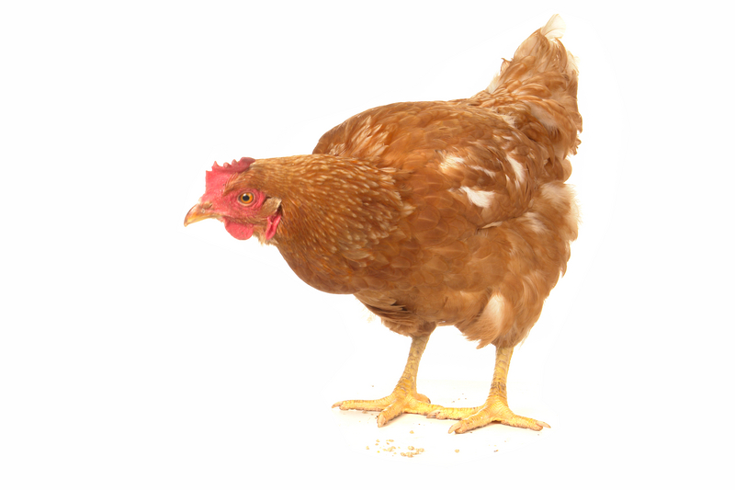
Chicken growth and development.

Slide 2
Chickens…where did it come from?
Gallus domesticus- latin name for common chicken.
Archaeological evidence suggests that the bird commonly known as the chicken is a domesticated version of the Indian and Southeast Asian Red Jungle Fowl (Gallus gallus) which is still found in the wild today. It is thought that the bird was first tamed in China around 6000 BC, with the birds moving into India by 2000 B.C. The chicken then spread from China to Russia and from there into Europe between 750 B.C. – 42 A.D. Some scholars believe that the bird may have been domesticated first for its use in cockfighting, and only later used as a food source.

Slide 3
Domestication…
over 400 different breeds of chickens

Slide 4
Chook biology…
An adult male chicken is referred to as a “rooster,” adult females are called “hens,” and newly hatched birds are “chicks.”
Fertilized eggs will hatch after 20-22 days and the chick will weigh just 50 grams after hatching, and between 1.5 and 3.5 kg when fully grown.

Slide 5
Biology…
The bird’s skeleton is lightweight, and some of the bones, the so-called “pneumatic bones,” are hollow and act as an extension of the respiratory system. The lungs are stiff, and do not expand or contract very much as the chicken breathes. It is important to remember when holding or restraining a chicken that the breastbone of the chicken, called the “keel,” must be able to move freely or the bird might suffocate

Slide 6
Scarce as hens teeth…
Even without teeth, chickens have one of the most efficient digestive systems in the animal kingdom.
From beak to vent in only 2.5 hours!
They use grit in their gizzard to help break down their food.

Slide 7
Digestive system…
Chickens do not have teeth or lips, and instead use their beaks to tear off bits of food.
The tongue of the chicken is barbed to help food move backward toward the esophagus. In the esophagus is a small pouch, called a crop, where food is stored briefly before moving into the stomach where it is mixed with hydrochloric acid and pepsin.
From there, the food moves into the muscular gizzard which is used to crush and grind the food, with the help of small amounts of gravel and grit that the bird has swallowed.

Slide 8
Digestive system…
http://vimeo.com/74977796

Slide 9
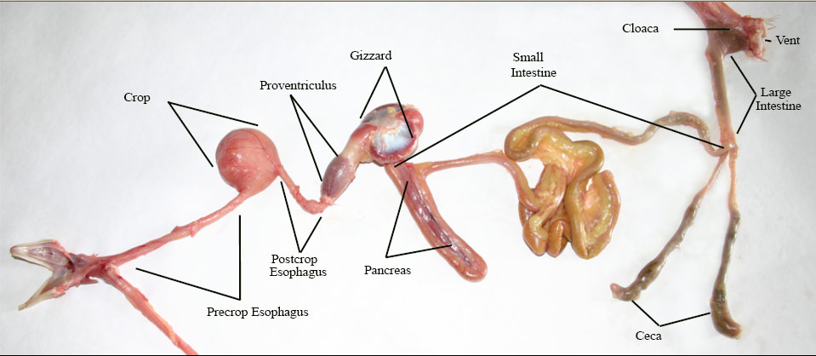

Slide 10
From the esophagus food moves to the crop, an expandable storage compartment located at the base of the chicken’s neck, where it can remain for up to 12 hours. The food trickles from the crop into the bird’s stomach (proventriculus or gizzard) where digestive enzymes are added to the mix and physical grinding of the food occurs.

Slide 11
Although hens are born with two ovaries and oviducts, usually only the left one will develop and become functional.
Eggs are laid by passing through the cloaca, a chamber which is also the passageway for faeces via the rectum, and urine via the ureters.

Slide 12
The process…
Mouth: It all starts here.
Esophagus (Gullet): Transports food from the mouth to the stomach.
Crop: A pouch in the esophagus used to store food temporarily before moving it on to the stomach.
Stomach (Proventriculus/Gizzard):Principally the organ where food is broken into smaller units. It has two parts: theproventriculus for storage and the gizzard. The gizzard is a muscular part of the stomach that uses grit to grind grains and fiber into smaller particles.
Small Intestine: Aids in digestion and nutrient absorption. Composed of the duodenum, jejunum and ileum.
Liver: The largest glandular organ in the body. Aids in the metabolism of carbohydrates, fats and proteins.
Ceca: Bacterial action in the ceca helps break down undigested food passing through the intestine. The ceca turns into the large intestine, which connects with the cloaca.
Large Intestine: Functions primarily to absorb water, dry out indigestible foods and eliminate waste products.
Cloaca: Where the digestive, urinary and reproductive systems meet.
Urinary System: Consists of two kidneys and two ureters. The kidneys are located in the pelvic bones. They filter waste from the blood and pass it through the ureter to the outside via the cloaca/vent.
Vent: The external opening of the cloaca that passes waste to the outside.

Slide 13
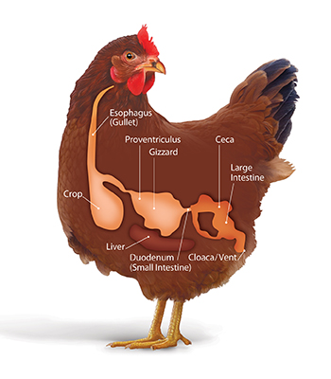

Slide 14
TASK…
Draw a diagram to show the digestive system of a chicken and label each part, describing what each does. (use internet to research the role of each part of its digestive system).

