Slide 1
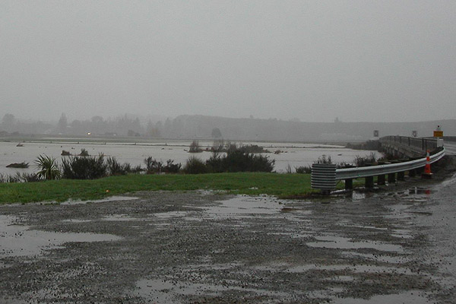
Climate

Slide 2
What is Climate?
Climate is the measure of the average pattern and changes in temperature, wind, humidity, sunshine hours and rainfall in a particular region over a long period of time ie seasons, months years.
Climate is different to weather in that weather only measures the short term conditions in a certain region…ie. Weeks or days.

Slide 3
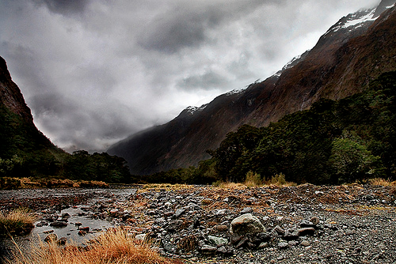
The climate of a region is effected by its latitude, terrain/topography, altitude, as well as bodies of water and their currents. New Zealand has a very complex and variable climate…

Slide 4
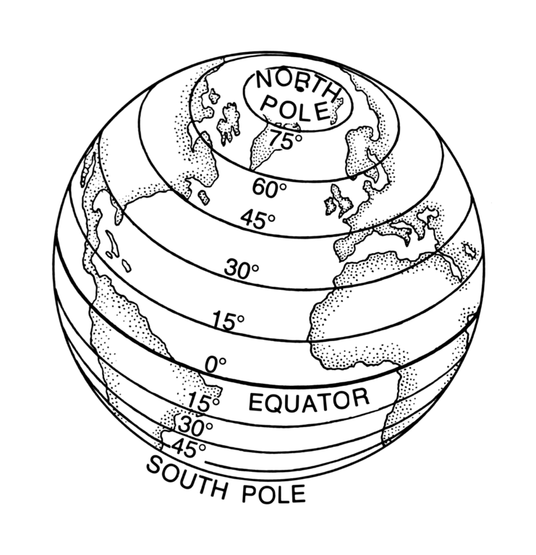
Latitude…
Latitudes are the horizontal bands by which we map the globe and our positions on it.
Lower latitudes are warmer, higher are colder… as you get closer to the poles or further from the tropics…

Slide 5
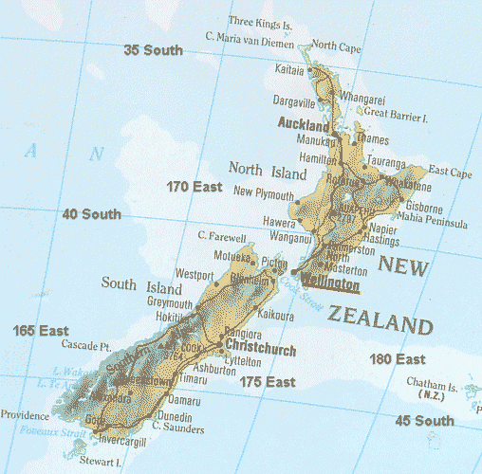
New Zealand ranges from latitude 50 South, in the sub-Antarctic Islands to latitude 35 South at the tip of Cape Reinga

Slide 6
Because of our long country it crosses many latitudes which effect its climate. It ranges from sub-tropical to sub-Antarctic.
While the far north has subtropical weather during summer, and inland alpine areas of the South Island can be as cold as -10°C (14°F) in winter, most of the country lies close to the coast, which means mild temperatures. The average New Zealand temperature decreases as you travel south.
Where there is little dramatic variation over the seasons that climate is described as TEMPERATE.ie Dunedin is a temperate, coastal climate which is hilly with weather patterns coming mainly from the southerly Antarctic ocean currents, cool ocean breezes in Summer and mild winters.

Slide 7
World climate classifications

Slide 8
Terrain…
Mountain chains extending the length of New Zealand provide a barrier for the prevailing westerly winds, dividing the country into dramatically different climate regions. The West Coast of the South Island is the wettest area of New Zealand, whereas the area to the east of the mountains, just over 100 km away, is the driest.

Slide 9
We have high, steep mountains that create a barrier from the Tasman Sea and its prevailing weather. Weathered and eroded rolling hill country, nutrient rich plains, river valleys, volcanoes, expansive coastlines, forested hills…we even have areas that are almost desert. Our country has a huge variety of terrain.
A good way to get an idea of the high and low, undulating and flat areas is to look at a topographic map…

Slide 11
Rainfall…
Most areas of New Zealand have between 600 and 1600 mm of rainfall, spread throughout the year with a dry period during the summer. Over the northern and central areas of New Zealand more rainfall falls in winter than in summer, whereas for much of the southern part of New Zealand, winter is the season of least rainfall.

Slide 13
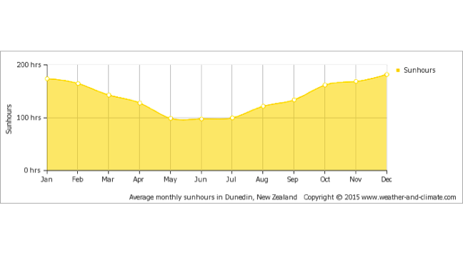
Sunlight hours…
In Winter our days are short, but we have very long days in Summer…How might this affect plant grow and farmer productivity do you think?

Slide 14
Humidity…
Humidity is a measure of the water vapour content of the air at a given temperature. The amount of moisture in the air is compared with the maximum amount that the air could contain at the same temperature and expressed as a percentage.

Slide 15
Task…
This graph shows the hourly temperature (°C) and relative humidity (%) readings for Hamilton for the last week of May.

Slide 16
Task…
Interpreting graphs:
What normally happens to the temperature at night?
Was the relative humidity higher at night or during the day?
When is it usually the warmest time of the day?
Is the relative humidity usually higher or lower at this time, compared to the rest of the day.

Slide 17
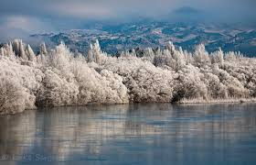
Frost and snow…
Most snow in New Zealand falls in the mountain areas. Snow rarely falls in the coastal areas of the North Island and west of the South Island, although the east and south of the South Island may experience some snow in winter. Frosts can occur anywhere in New Zealand and usually form on cold nights with clear skies and little wind.

Slide 18
Coastal/inland…
Much of New Zealand is coastal, which means much our the countries climate is affected by the ocean.
Ocean currents, cool ocean winds,

Slide 19
Wind…
Some areas of NZ are definitely windier than others, Wellington for example. This is produced because of the funneling effect of the prevailing wind being pressurized by Cook Strait and being exposed to the coast with no Mountains to shelter.
We have a lot of wind… with two prevailing air currents…El Nino, or La Nina that are produced by winds and ocean currents.

Slide 20
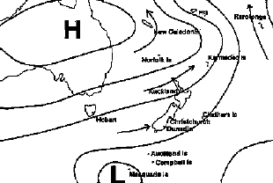
El Nino
During El Niño, New Zealand tends to experience stronger or more frequent winds from the west in summer, typically leading to drought in east coast areas and more rain in the west. In winter, the winds tend to be more from the south, bringing colder conditions to both the land and the surrounding ocean. In spring and autumn south-westerly winds are more common.

Slide 21
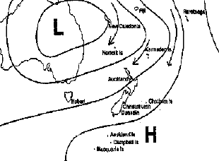
La Nina..
La Niña events have different impacts on New Zealand's climate. More north-easterly winds are characteristic, which tend to bring moist, rainy conditions to the north-east of the North Island, and reduced rainfall to the south and south-west of the South Island. Therefore, some areas, such as central Otago and South Canterbury, can experience drought in both El Niño and La Niña. Warmer than normal temperatures typically occur over much of the country during La Niña, although there are regional and seasonal exceptions.

Slide 22
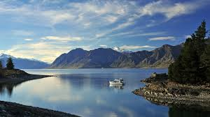
Other water bodies…
Lakes and rivers, glaciers etc…
How might these effect the climate?

Slide 23
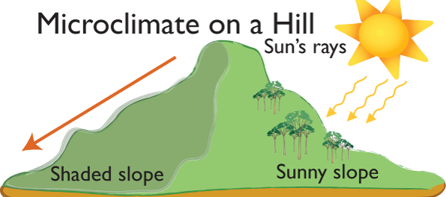
Micro-climates…
A microclimate is the climate of a small area that is different from the area around it. It may be warmer or colder, wetter or drier, or more or less prone to frosts. Microclimates may be quite small - a protected courtyard next to a building, for example, that is warmer than an exposed field nearby
Where in Dunedin might you experience a Micro – climate?

Slide 24
Aspect…
Aspect relates to which direction you are facing… North, South, East, West…
The climate of a property that has a North facing aspect will most likely get more sunlight in New Zealand, therefore perhaps be drier and warmer.
This can be dependent on terrain such as hills and mountains and which side of them you are on. Shade etc.

Slide 25
Tasks…
Use the NIWA website, regional council sites or any other sites you can to find to gather information, graphs, patterns that describe the Climatic conditions of your area.
Include information on your regions wind, annual temperature and rainfall, terrain, latitude and position. Include information on any major water bodies, humidity, snow/frost info. Use pictures to help demonstrate/describe the factors that effect the climate in your region.

