Slide 1
Collage and assemblage after cubism…

Slide 2
Dada…
Dada was born out of negative reaction to the horrors of World War I.
Anti-art: Dada represented the opposite of everything which art stood for.
Anti-war:the movement was a protest against the bourgeois nationalist and colonialist interests, which many Dadaists believed were the root cause of the war, and against the cultural and intellectual conformity—in art and more broadly in society—that corresponded to the war
Anti-bourgeois

Slide 3
As Hugo Ball expressed it, "For us, art is not an end in itself ... but it is an opportunity for the true perception and criticism of the times we live in.”
Dada rejected reason and logic, prizing nonsense, irrationality and intuition.

Slide 4
Hannah Hoch
Hannah Höch
1919
Collage of pasted papers.

Slide 5
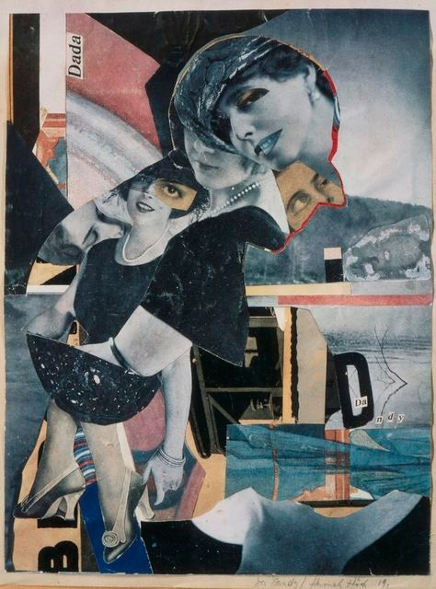
German Da-da ist
Female… the only woman Dadaist
Appropriated and rearranged images and text from the mass media to critique the failings of the Weimar German Government.
Pioneering feminist

Slide 6
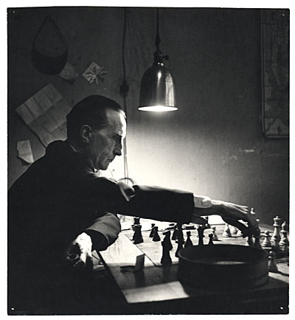
Marcel Duchamp
Fountain
1917
Urinal, paint.

Slide 7
The ‘ready-made’
Duchamp wanted to put art back in the service of the mind.

Slide 8
‘Nude descending a staircase’
1911-12
Oil on canvas

Slide 9
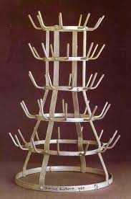

Slide 10
Robert Raushenburg…

Slide 11
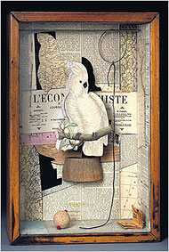
Joseph Cornell…

