Slide 1
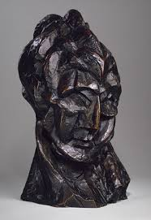
Cubist sculpture…
CUBIST SCULPTURE

Slide 2
Not a major part of the cubist movement, sculpture was none the less a part of its development and a huge influence on other sculptors to come…

Slide 3
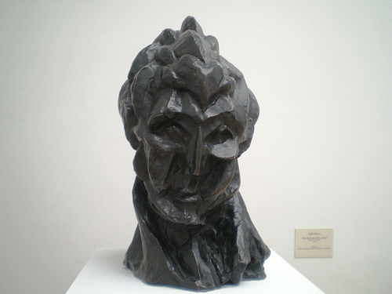
…the first true Cubist sculpture was Picasso’s “Womans Head”. Created as a 3 dimensional experiment relating to his paintings at the time to test, in ‘reality’, the expression of volume through faceting, and be a reference for his paintings during the Analytical period. There is some simultaneity, a textured surface, an influence from Cezanne and primitive sculpture and an exploration of natural light on an actual Cubist surface, and thus also enabling them to properly explore the ideas of multiple viewpoints.
Picasso. “Woman’s head” .
1909,1910. Bronze.

Slide 4
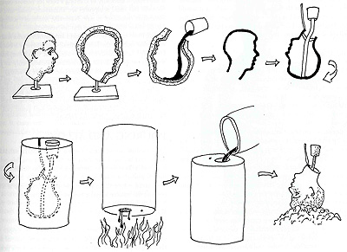
Bronze casting…
The “lost wax” method…

Slide 5
First the sculptor sculpts the sculpture out of wax. Wax is maleable and easy to sculpt.
Wax tubes, called runners, are then attached, with a wax cup. This will later be where the bronze is poured in and where the liquid wax and air can escape from, these are called the risers or sprues.
Then it is coated in a ceramic/silica mix which is then baked to harden it. As it is baked (1000degrees) the wax melts out, leaving a hollow, hardened shell. The negative space.

Slide 6
Molten bronze is then poured into the shell.
After the bronze has cooled the ceramic shell is chipped off.
The risers and runners are hack-sawed off and the area ground down, any other tidying of the bronze is done.
A patina is added to colour the bronze. This is usually done by adding a chemical to the heated scupture.

Slide 7
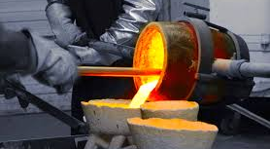
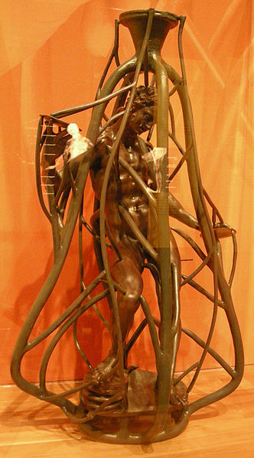
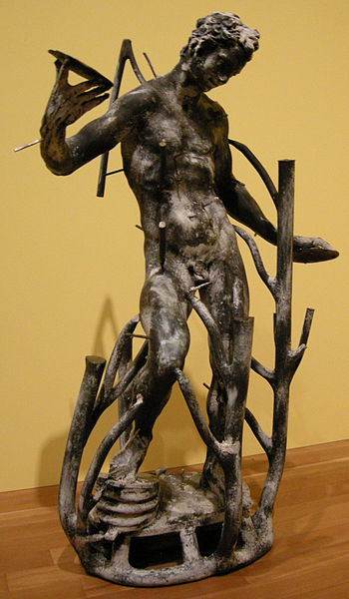

Slide 8
Picasso’s next major sculpture didn’t really happen for quite a few years later….in 1914, and this is where Cubist Sculpture began to gather some momentum. “Absinthe glass” drew on Synthetic cubism’s idea of the tableau-objet (the picture as object), and took it the next step further, raising even more questions about reality: mass suggested by space, the object separated from function, real and fake objects.

Slide 9
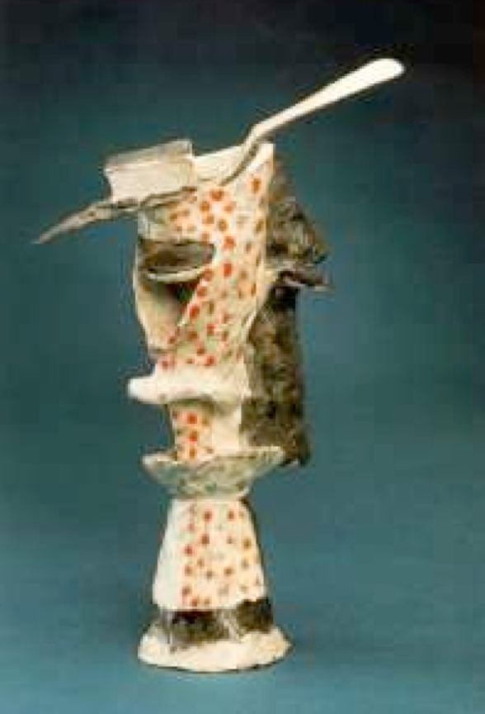
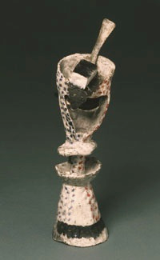
“Absinthe glass”, Picasso, 1914. (Two versions of ).

Slide 10
-The inside of the glass has been made into twisting planes, reversing the void into a solid, and often vice-versa.
-tries to show interior and exterior simultaneously
-uses pointillist technique to decorate the surface and add texture (real and fake textures).
This is an example of an ‘assemblage’; using bits of found material, wood, actual objects etc and then decoratively painted to form something else.

Slide 11
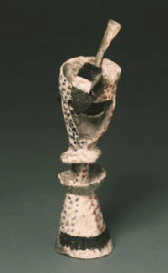
ASSEMBLAGE:
Picasso created a hand-painted bronze cast that he combined with a real spoon.
Assemblage is an artistic technique, very similar to collage, that combines, or assembles, objects into a piece of artwork. The result of an assembled piece work of art could contain any variety or combination of objects. The key difference between assemblage and collage is that assemblage is considered more three-dimensional in structure; although it may not be readily apparent which technique had been applied

Slide 12
Another form of cubist sculpture are the ‘constructions’, which used mainly pre-cut bits and pieces which are worked out and constructed into something else, using synthetic cubism’s big bold planes and ideas of collage.

Slide 13
