Slide 1
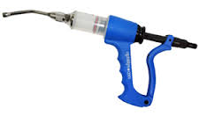
Drenching

Slide 2
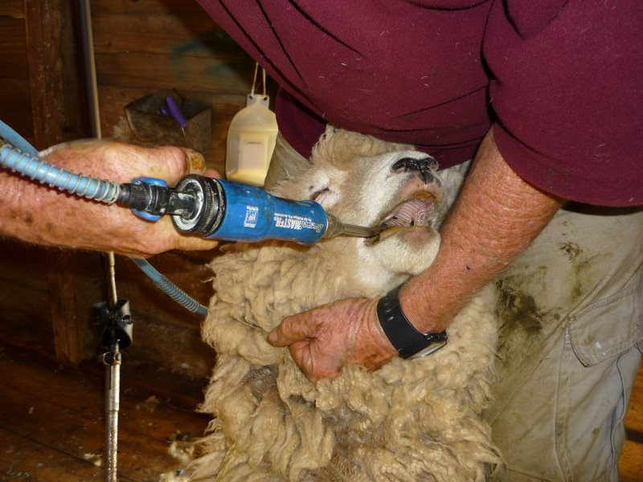
Drenching…
What is drenching?
Parasites can be picked up from the soil and pastures when stock graze. Drenching helps deal with them once they have entered the body of an animal and will help prevent the spread of more parasites or their eggs or larvae. Parasite use some of the needed nutrients that the animal consumes, meaning less is available for good healthy growth.
Why do farmers drench?
Sheep and Cattle of all ages need to be drenched for internal parasites, each class of stock being treated in a different way as they have different needs.
Signs of parasitism can include:
Dags, soft faeces, scouring
Ill thrift, low growth rate.
Any new stock entering a farm should be drenched, this is called quarantine drenching. It is to prevent spread of parasites onto the pasture from the new stock.
Lambs are more susceptable and are usually the first to be affected.

Slide 3
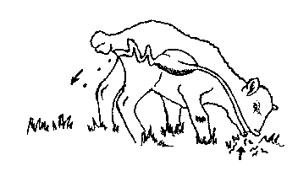
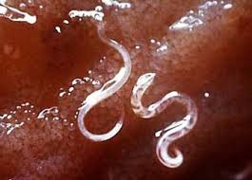

Slide 4
Parasite lifecycle.

Slide 6
Drenching…
One of the worst parasites is:
Haemonchus Contortus
Commonly known as Barbers Pole Worm, this is a concern for sheep farms from as early as December through to as late as April. Mature Haemonchus living in the gut of the sheep feed off the animals blood. A severe burden can cause death by anaemia in a relatively short period of time.
A mature female Haemonchus Contortus can lay up to 10,000 eggs per day. Haemonchus Contortus does not always cause scouring.
Being prepared and early prevention is the best defence against this deadly worm, not only for protecting stock but in reducing the re burdening of the soil by the next generation of larvae.
Many drenches will kill Haemonchus Contortus but only a select few will give a persistent activity, providing you with worry protection.

Slide 7
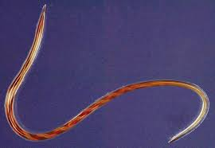

Slide 8
Drenching…
When sheep start showing signs of anaemia they begin to slow down, become lethargic, eventually go down and finally die. The inside of the eyelid and gums will be pale in colour due to the lack of blood. If Sheep show signs of slowing during Haemonchus Contortus risk period should be drenched immediately with a good quality drench with a persistent activity claim for Haemonchus Contortus. The entire flock should be drenched as it is usually wide spread.

Slide 9
Drench resistance
Depending on the type of drench: there are 3 main types… three broad-spectrum drench families: Benzimidazole (BZ or white), Levamisole (Lev or clear) and Mectin (Endectocide or Macrocyclic Lactone (ML), e.g. ivermectin, abamectin and moxidectin).
Drenching is done according to animal weight. Under drenching can cause resistance.

Slide 10
Drench resistance is a change in the genes in a worm population which allows certain worms to survive exposure to drench.
This change comes from continued exposure of the population to the drench. Drench resistance is not “all or nothing”. A drench will range in efficacy, depending on how many genetically “improved” worms are present on your farm

Slide 11
Task
Use this website to find out more about drench resistance and answer these questions…
What are the causes of resistance and how does it develop?
What can a farmer do to prevent resistance?
How can a farmer detect resistance?

Slide 12
Lambs…
Young stock are more susceptible to the effects of a worm burden than adult stock and are less able to control a worm burden for themselves until their immune system matures at around twelve months of age. Lambs are more affected by tapeworm than adult stock and therefore should be drenched with a good quality drench with a tapeworm claim. There are many drenches that state they kill tapeworm that only control the segments, leaving the head behind to keep producing segments and more eggs.
As a guide for lambs:
Drenching should start at weaning (or earlier if showing signs of parasitism)
During times of high worm burden and when pasture is low to the ground use either a long acting capsule or drench at 4—6 weekly intervals with a tape drench.
Ensure lambs are protected during Haemonchus Contortus risk period with a drench that has a persistent activity claim. (Usually Dec—May but may occur outside of these months)
Drench when you perceive a need, ie the sheep appear to be suffering from parasitism.

Slide 13
Mineral deficiency
A common deficiency in NZ is Selenium (as it is not present in the soils of up to 30% of our farms). It is important for maintaining a healthy immune system. If deficient… growth rates slow, production slows and white muscle disease can occur.
White muscle disease is a degeneration of muscle. Usually in younger animals, symptoms vary from mild stiffness to obvious pain upon walking, to an inability to stand. Shaking.
Many drenches contain selenium and sometimes other minerals, some drenches are combinations of parasite control and mineral suppliment.

Slide 14
White muscle disease.

Slide 15
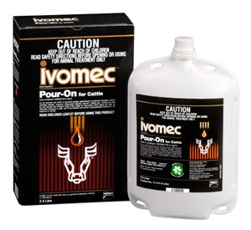
Task:
Research types of drenches and what they offer ie. Cydectin, ivomectin, Albendazle/Levamisole….
http://www.pggwrightson.co.nz/ProductCatalog/DisplayCategory/1
Make a list of the different brands, their active ingredient/s and what they target.

Slide 16
How to drench…
https://www.youtube.com/watch?v=DoicpFUxbfs

