Slide 1
Ze Germans!

Slide 2
Germany during the Early Modernism era was considered at the fore, prolifically producing some of the best intellectuals, scientists, philosophers, artists and thinkers in the world at the time. And one of the most ‘Fertile’ places in history for the flourishing of Modern art and Science… caused by a booming trade, construction and communications.
What was called the Weimar Republic (before becoming Hitlers Third Reich) was chaotic and passionate politically. Particularly after Germanys defeat in WW1 and Hitler rise to power in 1933 Germany was a progressive hub for intellectuals… “frequently cited as one of those with the highest level of intellectual production in human history; Germany was the country with the most advanced science, technology, literature, philosophy and art.”

Slide 3
Einstein and many others, before fleeing to the USA because of Hitler, lived and worked here at the time, particularly Berlin.
"Remarkable for the way it emerged from a catastrophe, (WW1) more remarkable for the way it vanished into a still greater catastrophe, the world of Weimar represents modernism in its most vivid manifestation."

Slide 4
During the era of the Weimar Republic, Germany became a center of intellectual thought at its universities, and most notably social and political theory (especially Marxism) was combined with Freudian psychoanalysis to form the highly influential discipline of Critical Theory. (Critical theory is a school of thought that stresses the reflective assessment and critique of society and culture by applying knowledge from the social sciences and the humanities.)

Slide 5
The Weimar Republic era began in the midst of several major movements in the fine arts that continued into the 1920s. German Expressionism had begun before World War I and continued to have a strong influence throughout the 1920s.
”…worked in different styles, but shared many themes: the horrors of war, social hypocrisy and moral decadence, the plight of the poor and the rise of Nazism”.

Slide 6
German Expressionism
A fascination with the enticing yet often sordid experiences of modern urban life; the enduring solace associated with nature and religion; the naked body and its potential to signify primal emotion; emotionally charged portraiture; and, most pivotally, the need to confront the devastating experience of World War I and its aftermath.

Slide 7
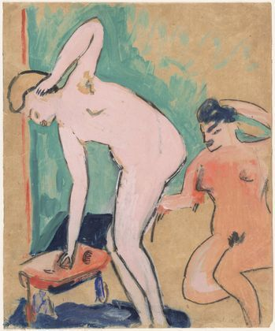
The naked body and its potential to signify primal emotion was a core Expressionist theme. The Expressionists' drive to get at inner experience led them to study the ways that bodily gestures, postures, and facial expressions could communicate essential states of being.
Erich Heckel, 2 female Nudes.

Slide 8
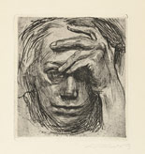
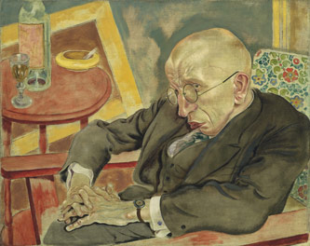
Portraiture underwent a dramatic transformation in the modern era, perhaps most definitively in the hands of the Expressionists. Rather than flattering the sitter or focusing on external appearances, Expressionist portraits explore "inner feelings" and issues of the psyche.
George Grosz. The poet, Mx Herman-Nesse. 1927
Kathe Kollwitz.Self portrait, hand at the forehead.

Slide 9
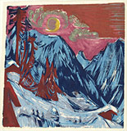
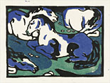
Expressionist landscapes extended from a long Romantic tradition that viewed nature as an antidote to the stresses and corruption of modern life. Blaue Reiter artists retreated to the Alpine village of Murnau near Munich to live and paint in harmony with nature, using it as inspiration for their colorful, increasingly abstract landscapes. The Brücke artists' images of themselves and their girlfriends frolicking in the nude at the lakes outside Dresden can be broadly related to back-to-nature and nudist movements
Ernst Ludwig-Kirchner.Winter, moonlit night.
Franz Marc. Horses resting 1911.

Slide 10
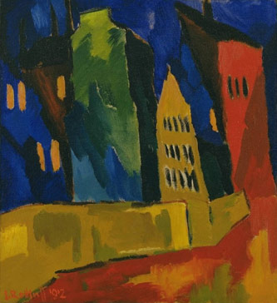
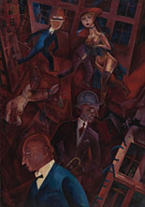
As a result of an intensely rapid period of industrialization in the 19th century, German cities experienced an explosion in size and population density between German unification, in 1871, and 1910. The Expressionists approached the modern city with ambivalence. On the one hand, they recognized the dehumanizing and alienating effects of an urban lifestyle. Yet at the same time, they celebrated the excitement and vitality of its bustling pace and multifarious attractions.
Karl Schmidt-Rottluf. Houses at Night.
George Grosz. Metroplos 1917

Slide 11
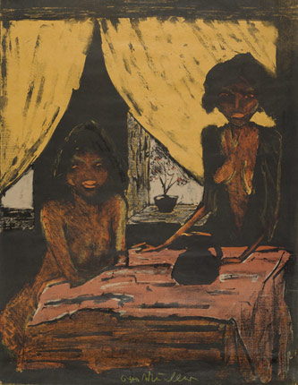
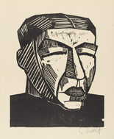
Expressionists looked outside mainstream European society for inspiration, from far-flung tribal societies in Africa and the South Pacific to the peasantry and folk art traditions closer to home. Stylistically, they borrowed bold volumetric shapes, geometric ornamentation, decorative patterning, and flattened planes from art and objects encountered in ethnographic museums and commercial galleries, at exhibitions at World’s Fairs and zoos, and in reproductions in books and periodicals.

Slide 12
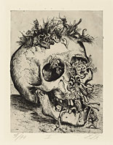
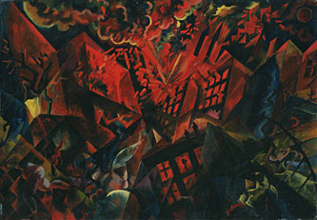
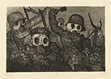
When World War I broke out in August 1914, many Expressionists initially believed it could be the apocalyptic event that would at last overthrow the self-satisfied materialism of the nation’s monarchy and bourgeoisie. Many artists enlisted for active duty or were drafted; others avoided the front lines by volunteering for the medical corps

Slide 13
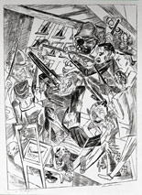
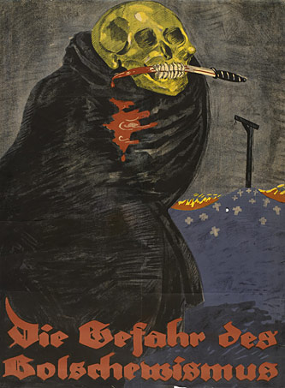
In November 1918, World War I ended with the military defeat of Germany, and a political revolution led to the creation of Germany's first democracy, the Weimar Republic, in 1919. During the immediate postwar period, many artists became politically engaged, hoping that a new, more liberal and open society might at last be at hand. But instability plagued the new republic, leading to violence, extremism, and a feeling of anarchy and fear.

Slide 14
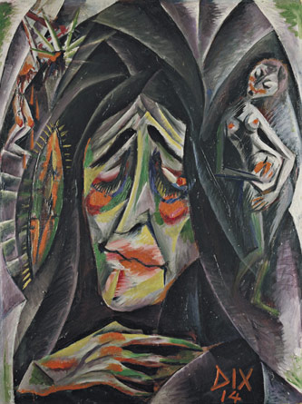
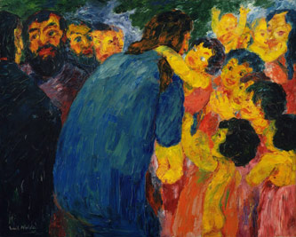
For the Expressionists, art and religion were closely intertwined, as both involved surrender to an inner, spiritual energy and a preoccupation with the human soul. Although they lived in an age of intellectual skepticism and philosophical nihilism, the Expressionists were still drawn repeatedly to the Christian themes and motifs that had shaped German life and culture for centuries

Slide 15
DADA…
Dada was born out of negative reaction to the horrors of World War I. This international movement was begun by a group of artists and poets associated with the Cabaret Voltaire in Zurich. Dada rejected reason and logic, prizing nonsense, irrationality and intuition.

Slide 16
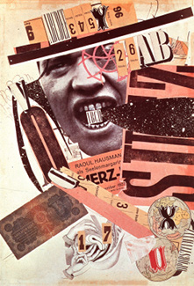
Dada was not art: it was "anti-art.” Dada represented the opposite of everything which art stood for. Where art was concerned with traditional aesthetics, Dada ignored aesthetics. If art was to appeal to sensibilities, Dada was intended to offend.

Slide 17
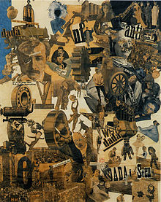
Art historians have described Dada as being, in large part, a "reaction to what many of these artists saw as nothing more than an insane spectacle of collective homicide."

Slide 19
The Dadaists – the "monteurs" (mechanics) – used scissors and glue rather than paintbrushes and paints to express their views of modern life through images presented by the media. A variation on the collage technique, photomontage utilized actual or reproductions of real photographs printed in the press. In Cologne, Max Ernst used images from World War I to illustrate messages of the destruction of war.

Slide 20
"We had lost confidence in our culture. Everything had to be demolished. We would begin again after the tabula rasa…we began by shocking common sense, public opinion, education, institutions, museums, good taste, in short, the whole prevailing order."

Slide 21
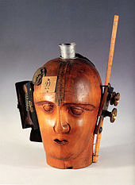
The assemblages were three-dimensional variations of the collage – the assembly of everyday objects to produce meaningful or meaningless (relative to the war) pieces of work including war objects and trash. Objects were nailed, screwed or fastened together in different fashions. Assemblages could be seen in the round or could be hung on a wall

