Slide 1
Reproductive Techniques
By Harrison Lawrence

Slide 2
Sire Recording/Selection
This is a process where the farmer will select a Bull or semen for A.I. that carries the traits the farmer desires. For example a dairy farmer may be selecting semen for his dairy cows for management purposes, were as a beef farmer may be looking to purchase a bull for his beef herd. Sires (Bull) have much more genetic influence in the herd than dams (Cow). This is because there is only one sire where there are more than one dam. 80% of a herds genetic improvement comes from the Sire. They can also determine the profitability of the farmers herd. Better performing Sires means more cash for the farmer and also an increase in genetic potential.

Slide 3
Steps
Culling is when the farmer sends an animal to the freezing works for money
Heritability determines the likelihood of the trait being passed onto the offspring
The farmer must decide what traits he would like to carry onto his future offspring i.e. Milk production or Wool Quality. It is important that the farmer chooses traits that are economically viable and have a High-Medium Heritability.
The farmer will then need to choose a Sire that is capable of passing down the desired traits to the offspring from a sire selection sheet which shows how heritable different traits are and all the offspring from that bull, this is also similar for A.I as well. He may use local sources or online sources for the Bull.
Once the bull is purchased the farmer will need to keep records of all offspring so that he can Cull any offspring that are not performing or showing the specific trait. Each animal should have a record of its sire and dam so its performance can be traced back.

Slide 4
C.I.D.R Device
C.I.D.R Stands for Controlled Internal Drug Release and is a T shaped device that is inserted with an insertion device into the cows vagina which then controls follicle stimulation by producing the drug progesterone, that stops the follicles maturing and producing eggs. The C.I.D.R is inserted into the vagina for 7 days and once removed 3 days after the cow will start normal oestrus cycle due to the sudden lack of progesterone. Follicles will now mature and produce eggs. C.I.D.R devices are often used in cohesion with Artificial Insemination for maximum genetic and economical potential. The farmer can time the heat of the cow so that Artificial Insemination is effective and so the farmer can get more milk production by timing the dates.

Slide 5
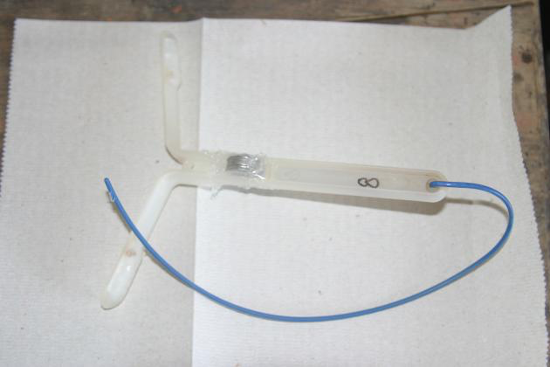
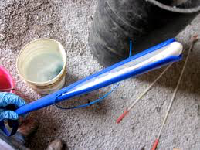
Items Used
CIDR device
CIDR applicator/Inserter
Lubrication
Disinfectant
Paper towels
Rubber Gloves
Crusher/Crate
A Cow

Slide 6
How to do It
Disinfect the C.I.D.R applicator by dipping it in a bucket of disinfectant and then into a bucket of water this is so the cow doesn’t get any infections or desieses.
Put on rubber gloves, this is because the progesterone on the C.I.D.R device can effect humans
Bend the endsof the T up and insert the C.I.D.R into the applicator with the tab facing down, this is so that the tab doesnt irritate the animal, this could cause the cow to pull the C.I.D.R out, or other cattle could pull it out with their teeth
Clean the Vulva with a paper- towel
Move the tail and insert the C.I.D.R by pushing it until you encounter resistance
Press the lever on the C.I.D.R applicator to dispense the divice and remove the applicator

Slide 7
C.I.D.R Device
T shaped end that holds the C.I.D.R in place.
Covered in the Drug Progesterone which is slowly released to stop follicle stimulation.
Cord to release the C.I.D.R Device.

Slide 8
Artificial Insemination A.I.
Artificial insemination (AI) is the process of collecting sperm cells from a Sire (Bull) and manually depositing them into the Dam (Cow). There a list of positive benefits to the farmer from A.I.
Increased efficiency of sire usage: A lot of semen is wasted during natural mating and there is also a high stress level which can effect the number of cows the bull can mate with where as with A.I. the semen can be diluted and expanded so that one ejaculation can create hundreds of samples that can be easily transported world wide if need be and also stored for long durations in some cases until the bull itself has died.

Slide 9
Increased potential for genetic selection: Very similar to Sire Selection although with A.I there are fewer bulls that have better Genetic potential. Because the bull can have more offspring their offspring can be used in a progeny test to determine the genetic value of the Sire.
Decreased costs, Increased Safety : Bulls on their own consume lots of feed so with A.I. the bull is off farm so the farmer wont have to worry about housing and feed for the animal. And also the health and safety of himself and the other animals on the farm.
Reduced disease transmission: It is less likely through A.I that diseases can be passed from the male to the female as the semen is check for diseases and is cured of any before being sold to the farmer

Slide 10
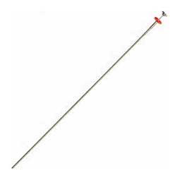
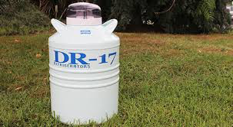
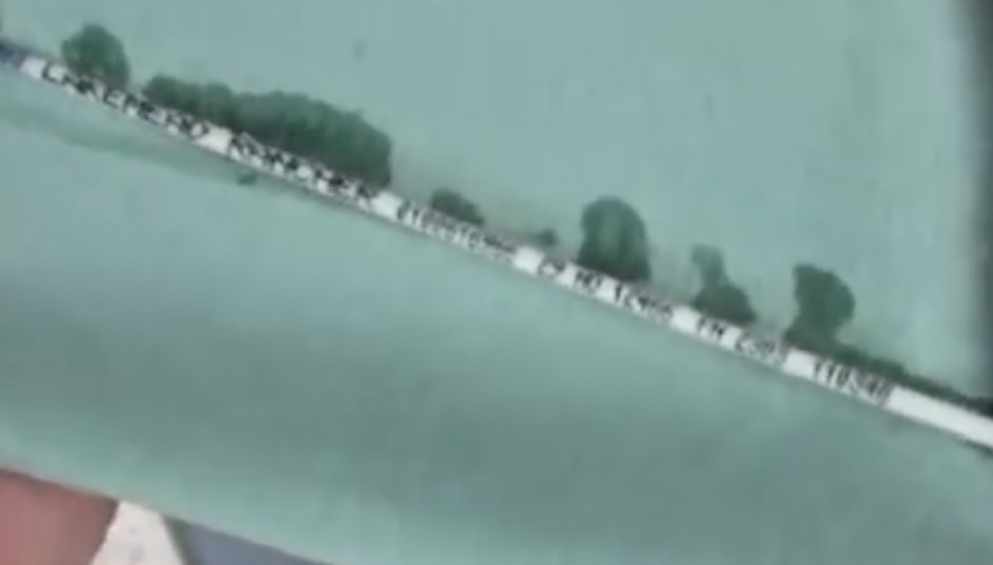
Items Used
Storage tank with Liquid Nitrogen to store the Semen straws
Water to thaw
Paper towels
Gloves (Shoulder Length)
A.I. Gun
Straw Cutter/Scissors
Lubrication
Plastic sheaths
Tweezers

Slide 11
How to do it
Remove straw from container with tweezers. Thaw the straw in the water and pre-heat the A.I. gun by rubbing it with a paper towel. Remove the straw from the water and dry in paper towel as water can destroy the semen within. (Do not replace straw in the container after thawing.
Once dried cut the straw with straw cutter or scissors at the crimped end then place it in the A.I. gun and cover with a sheath to stop sperm from escaping.
Put on glove with a generous amount of lubrication then gently insert hand into the anus in a cone position. Once in remove the faecal matter if need be without obsessive movement and completely removing the hand as this can cause a ballooning effect enabling you to grasp the cervix.

Slide 12
Move the hand from the upper part of the rectum to the lower part to identify the cervix. Hold the cervix with your thumb positioned on top while the rest of your fingers rest on the bottom.
Clean vulva to stop disease in the cow and then insert the A.I. gun at a 45degree angle until it touches the roof of the vagina. Level it so that it can go through the passage-way to the cervix. Push the cervix forward so that the vagina will stretch making it easier to insert the device.
Guide the gun to the cervical canal with the hand holding the cervix. Once the tip of the gun is here manipulate the cervix so that the gun can get through. Keep one finger at the end of the cervical canal so that you can feel when the gun has made it. Remove finger and slowly deposit semen. Remove A.I gun once all semen is deposited.
The process is complete now clean everything thoroughly.

Slide 13
Letter To Farmer
To Whom it may Concern
On your Southland farm with above average rainfall and prone to snow, running 750 mixed aged Friesian and Friesian /Jersey cross dairy cattle and 200 yearlings I recommend that you consider the two following reproductive techniques to enhance the timing, the genetic potential of your calves and the number of stock pregnant each year.
C.I.D.R Devices enhances the timing of heat in animals by slowly releasing the drug progesterone which stops the animal from cycling when the device is removed the animal will start normal oestrus cycle 3 days after. This will allow you to time when your cattle are on heat and when they could potentially calf giving you a timeframe to when the cow will start producing milk and earning profit. This can be Synchronized with the whole herd if need be. This can help at calving time as you will know around about when your cows are going to give birth allowing you also to time your feed to suit the cold climate and the animals nutritional needs as it is eating for two (Itself and the calf). This will improve the cash flow of your business as you will be producing more milk earlier in the season. It also allows you to pre-pair for A.I.

Slide 14
On average it takes 21 days for a cow to come back on heat. A good healthy cow can be expected to produce 1.8kg-2kg of milk solids a day at a price of $5.00 per Kg of milk solid. This mean you could potentially loose $189.00 - $200.00 per cow if a cycle is missed and they do not get impregnated. When you compare this with the cost of a C.I.D.R and the insemination of $59.00 (average cost) it is better to provide the C.I.D.R than loose profit. C.I.D.R can also be used to bring cows into heat that weren't naturally doing so and therefor not having to cull infertile cows which is a greater loss of up to $1800.00-$2000.00.
C.I.D.R Devices are also used in cohesion with artificial Insemination. A.I is when samples of a desired bulls semen are taken and extrapolated into straws which can then be deposited inside the female vagina. This process can allow you to select specific traits like milk production or Profit value that you would like to be inherited by the offspring of the animal (similar to sire selection). It is also a cheaper (the cost of an individual bull that may not actually work and grazing costs) and safer (Health and safety and no diseases can be passed on) way to impregnate cattle. This will increase profitability as you can be assured that all cattle are pregnant and will produce milk for the next season. Majority of the dairy industry are already using A.I on their farms now. A.I improves the Genetic performance/potential in your herd as you can be certain that these traits will be passed on as the donor bull will have lots of offspring and the breading value can be determined using a progeny test.
The Techniques above are definitely worth considering as they will improve timing, quantity, genetic potential and also the profitability of your southland business as you will have assured milk production which you can base your year around.

