Slide 2
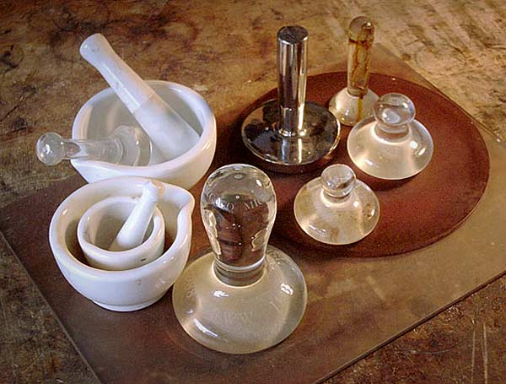
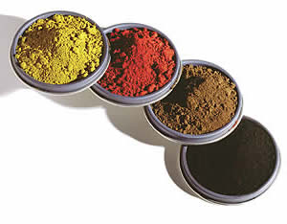
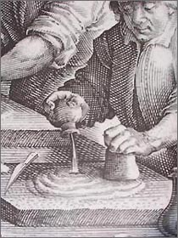
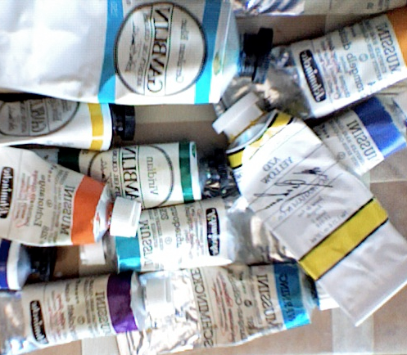
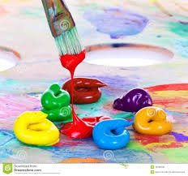
The process…

Slide 3
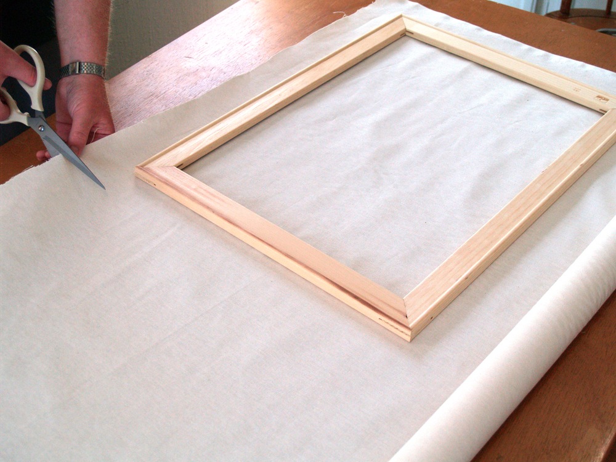
Stretching canvas…

Slide 4
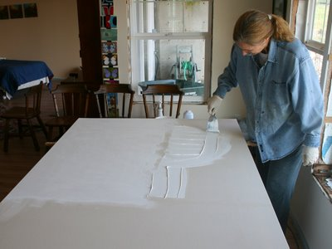
Gesso

Slide 5
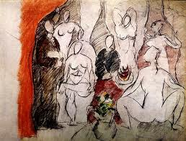
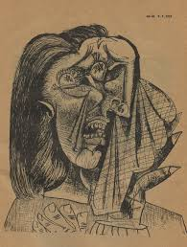
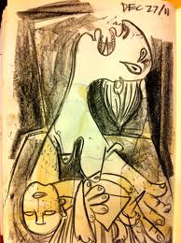
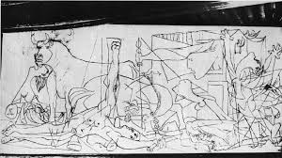
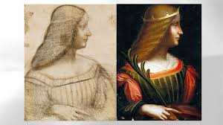

Slide 6
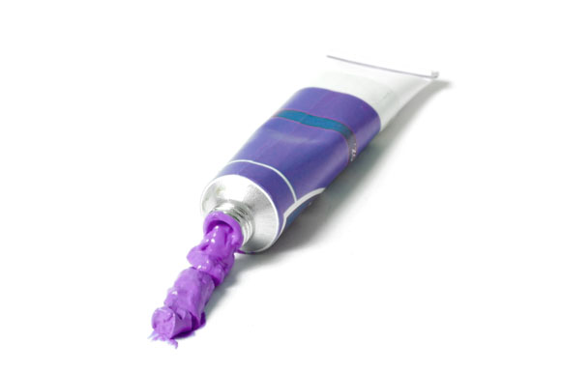
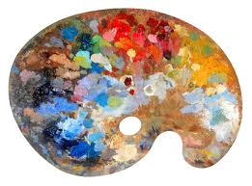
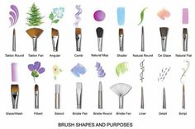
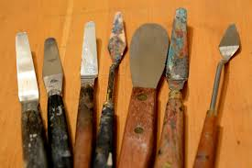
Application

Slide 7
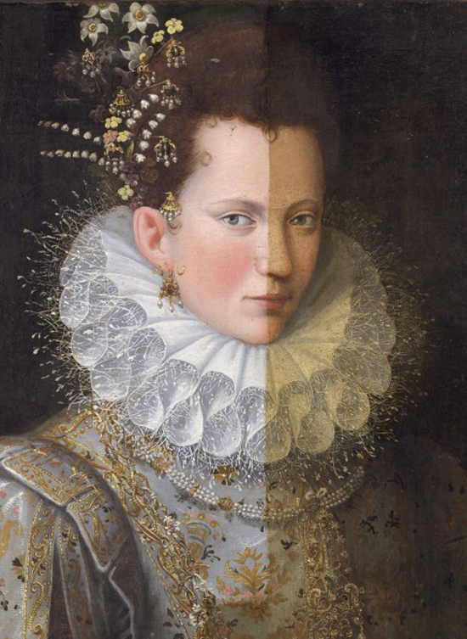
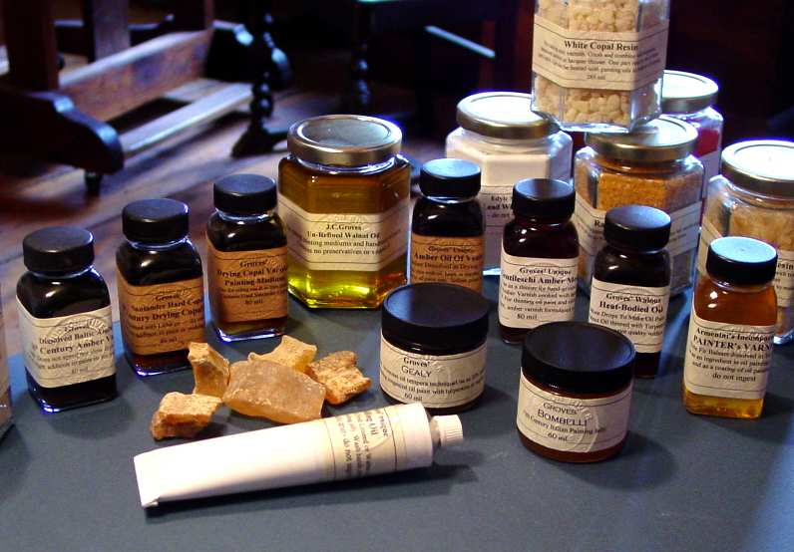
Varnish…

Slide 8
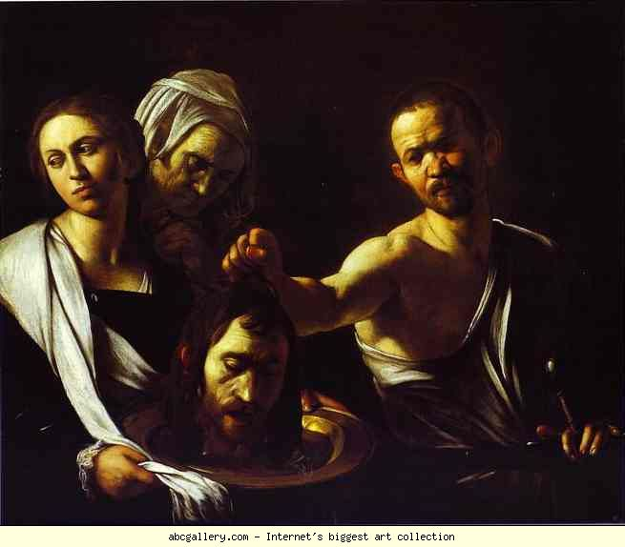
Oil painting techniques:
Chiaroscuro: A method of painting that represents boldly contrasting lighting, usually drawing highlights out of a dark scene. Also an element of this effect in any picture. Literally: italian ‘chiaro’ = light ‘scuro’ =dark.
Sfumato: literally ‘smokey’. A technique championed by da Vinci. Fuzzy effect created by fusing one tone into another
Scumbling: Scraping or scrubbing or dragging a thin layer of lighter opaque or semi-opaque color over a dark underpainting with a bristle brush, allowing the underpainting to show through.

Slide 9
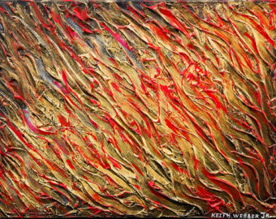
Impasto: Thick, heavily applied paint. A lot of texture. NOT smooth!
Highlight: the lightest part in a painting
Modelling: Indicating the three-dimensional form of an object by the appropriate distribution of different tones. Creating the illusion of volume by painting the effects of light and shadow on form.

Slide 10
Alla Prima: Painting, usually from life, in a direct manner: Completing a painting in a single session or while the paint is still wet. In past eras used primarily as a means of sketching, but which became a means of producing finished works of art by the impressionists. Literally “at once”.
_{Blending:}
Dry brush: a broken or mottled effect, revealing areas of paper or underpainting. Dry Brush – an effect when you have very little moisture on your brush to apply the paint. When you use a dry brush you need more of a scrubbing motion and it leaves a broken colour effect.
Glaze: film of transparent colour.
_{Scraffito: Scratching into} wet paint
Negative Space the space between objects or parts of an object. Also the space between an object and the edge of the canvas.
Brushwork – this describes the characteristic way that each artists paints. It is like your personal signature to your painting

Slide 11
Mass Tone - the undiluted colour of a pigment or paint when it’s in a large blob. Also known as mass colour.
Monochrome – a painting created in a range of tints and tones of a single colour.
Underpainting – the initial stage or first layer of an oil painting commonly executed using a monochrome or dead color as a base for the composition.

Slide 12
Oil paintings often possess an unsurpassed richness, depth and luminosity that lends itself well for capturing highly realistic objects and scenes.
It is very permanent and lasts well.

Slide 13
Layers of a painting

