Slide 1
Internal Assessment Resource Agricultural and Horticultural Science Level 2 AS 2.10
This resource supports assessment against:
Achievement Standard 91298
Report on the environmental impact of the production of a locally produced primary product

Slide 2
Context/setting
In this assessment activity, students are required to report on the environmental impact of the production of a locally produced primary product.
Students will participate in a field trip to a local dairy farm to gather information about the environmental impacts of the production system and its associated management practices.
During the field trip, students will gather information on the environmental impact of the production system and its associated management practices.
Following the field trip, students collate their information and prepare a report that integrates the environmental impacts and the stages of the production process responsible for the impacts.
The emphasis of Achievement Standard 91298 is on the quality of the report, including content, structure, and delivery.

Slide 3
Conditions
Students are responsible for gathering their own information on the field trip.
Some students may prefer to record their interview with the dairy farmer, rather than taking handwritten notes.
This is an individual assessment task. Students have 4 weeks of in and out-of-class time to complete it.

Slide 4
Achievement | Achievement with Merit | Achievement with Excellence
Report on the environmental impact of the production of a locally produced primary product. | Report effectively on the environmental impact of the production of a locally produced primary product. | Report comprehensively on the environmental impact of the production of a locally produced primary product.

Slide 5
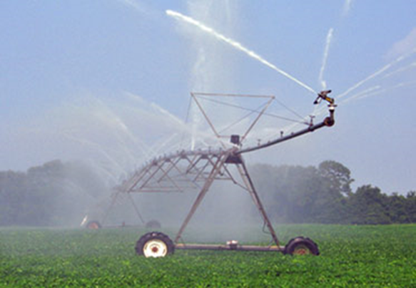
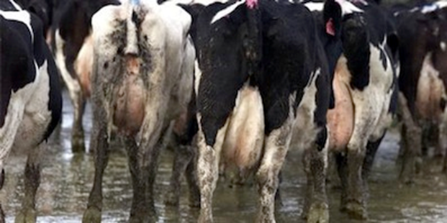
Impact of dairy farming on water quality.

Slide 6
Introduction:
Agriculture, in particular dairy farming, is having a considerable impact on the waterways of New Zealand. It is the relatively recent land use changes that are contributing to the degradation of water quality in New Zealand's waterways. Historically, land in New Zealand was dominated by sheep, beef and cropping, and the intensification of dairy farming and developments in technology are contributing to the increase in contaminants in streams and rivers. Sediment runoff, nutrient loss and animal excrement disposal some are the biggest polluters of waterways from agricultural practices, yet are generally of non-point source contamination

Slide 7
The degradation of water quality has implications for human health (from drinking contaminated water and pursuing recreational activities in contaminated waterways), and can be greatly detrimental to health over time. The quality of water quality can be determined by levels ofEscherichia coli (E. coli), cyanobacteria, nitrates, and phosphates.
What other aspects does it effect?

Slide 8
By following a pressures-indicators-responses framework, the impact of dairy farming can be clearly seen.
The pressures that agriculture and dairy farming put on waterways;
any indicators that would show a degradation in water quality as a result of dairy farming in the area; any potential trends that show increasing degradation or improving water quality; levels of indicatorsin the case study area of the Waiareka Creek within the Kakanui catchment of North Otago;
and the responses could be implemented to reduce the contamination of waterways by dairy farming activities are all things that are considered here.

Slide 9
Source contamination
Dairy farming has a particular effect on the quality of waterways due to the extensive application of nitrogen and phosphorus fertilizers, and the subsequent leaching of soils from irrigation of land (and in some cases, the over-application of both water and fertilizers). There is also the issue of animals being allowed access to streams and rivers

