Slide 1
Objectives
In this lesson you will learn to:
• describe how reproductive techniques, that improve the timing of reproduction, are carried out
• explain why these reproductive techniques are used.

Slide 2
Farmers manage the timing of their animals’ reproduction. The birth of new stock needs to fit in with when feed is available on the farm (usually spring), farm management and labour requirements, the needs of their animals and when animal products are needed by consumers.
Changing the time when animals are born can be done in three main ways:
1. Adjusting the timing of mating within the breeding season
2. Altering the timing of oestrus
3. Inducing birth.

Slide 3
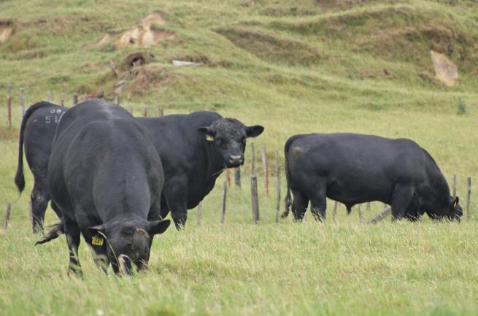
ADJUSTING THE TIMING OF MATING
Usually sires are kept quite separate from dams until a farmer wants them to mate.
Males are kept by themselves in paddocks well away from the females.
CATTLE
Cattle can breed all through the year, but a farmer may want to vary mating times to fit in with the requirements of producer companies.
A dairy farmer supplying milk to a dairy factory will try to get all cows breeding over a short period. This is because the cows are dried off over the winter months prior to calving. When they calve, they start milk production – usually around August. It is more profitable for the farmer to have all cows coming into milk production over a short period as the cows will be in milk longer.
Bulls in a paddock away from the cows and heifers.

Slide 4
IMPROVING THE TIMING OF REPRODUCTION
Some dairy farmers may take advantage of higher prices paid for milk over winter.
There is always consumer demand for fresh milk and it is more economical for dairy factories to keep processing milk all year round. So dairy factories pay more for milk in winter as it is harder for the farmers to produce. This is because there is less feed for the cows as the cold temperatures slow down pasture growth.
Cows need to calve in autumn to start off the winter milk production. To get the cows to calve next autumn they must be mated about mid-winter. Some herds have cows calving in autumn and the rest of the herd calving in spring to give a continual supply of milk all year.

Slide 5
Sheep…
Sheep are usually mated early in the breeding season, so that lambs are born in spring, and grown ready for slaughter (or sale) by December, or earlier. Having lambs at about the same age makes farm work easier, and the whole lot (or large groups) can be sold at once.
The timing of mating has to be worked out according to the length of gestation, so that the offspring are born when they are wanted.

Slide 6
Choosing when to put the bulls with cows, or the rams with the ewes, is the most common way of changing the timing of mating. However, altering the timing of oestrus is a common reproductive technique that has many advantages.

Slide 7
ALTERING THE TIMING OF AND SYNCHRONISING OESTRUS
The timing of when a group of animals naturally comes into oestrus can be changed. It can be altered so that they all come into oestrus at the same time (synchronisation).
This may be done by:
• day-length manipulation
•introducing a male to stimulate oestrus
• using hormones to synchronise oestrus.
DAY-LENGTH MANIPULATION
This is normally only used on animals that are kept indoors, because the light levels can be manipulated. Overseas, sheep may have oestrus induced by being kept indoors and being exposed to shorter ‘day’, when the light is on for shorter periods. The farmer can divide the flock into two or three groups so that lambs are born at different times of the year to give a year-round supply of meat.
Day-length manipulation is rarely used in New Zealand, except occasionally in specialised breeding programmes. In New Zealand, day-length manipulation is usually only done on chickens, as they are one of the few animals kept indoors.

Slide 8
INTRODUCING A MALE TO STIMULATE OESTRUS
Many animals emit pheromones, or sex attractants, which stimulate the opposite sex. Rams can be used to synchronise oestrus in ewes with the pheromones they produce.
In the breeding season, ewes ovulate (release an ovum from their ovary) every 17 days. When a ewe ovulates for the first time in the breeding season, she does not show oestrus (heat) and so does not mate. This is called a silent heat. As she doesn’t get pregnant with her first cycle, she will ovulate again about 17 days later. This time, she shows oestrus and will allow a ram to mate with her. This is called an active heat. Ewes do not all come into their first oestrus at exactly the same time.
To help stimulate them to come into their first heat together, a few rams are introduced just before the breeding season starts.
After the ewes have come into their silent heat, the rams are removed. Most of the ewes will soon come into their first active heat at about the same time. The rams can then be reintroduced to the flock for tupping (mating).
The reproductive cycle of cows are not influenced by the presence of bulls, so synchronisation has to be achieved in other ways.

Slide 9
USE OF HORMONES TO SYNCHRONISE OESTRUS
Progesterone can be used to treat cows (and sheep) to alter the timing of oestrus. Progesterone suppresses the production of other reproductive hormones, particularly follicle stimulating hormone (FSH) which is involved in the oestrus cycle. The lack of FSH stops eggs developing and no oestrogen is produced, so sexual activity is stopped.
The progesterone is often released from a device placed in the vagina of the animal. CIDRs (Controlled Internal Drug Release), CueMate and PRID, are the brand names of some of these progesterone devices. The device is left in the vagina for about a week. Then when the device is removed the cow will come into heat two to four days later.

Slide 10
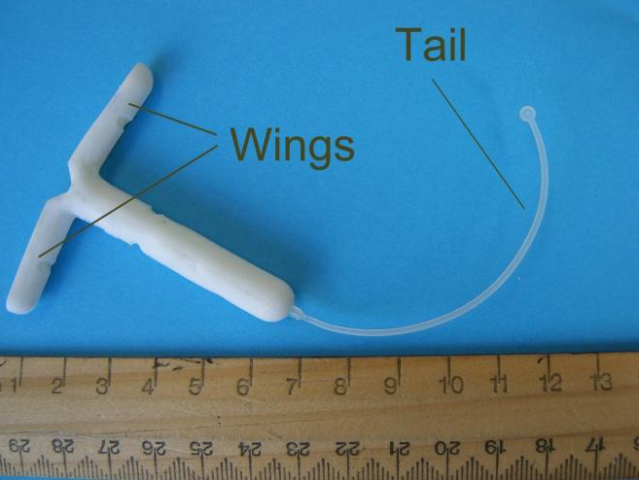
CueMate
The two pods contain progesterone. The flexible wishbone and soft treatment pods can have better retention in cows than other devices.
A CIDR for sheep.
CIDRs for cows are the same shape but larger.
Progesterone is impregnated into the silicone wings of the CIDR.

Slide 11
USING CIDRS AND CUEMATES
CIDR and CueMate devices are loaded into applicators with their wings, or pods, flattened together. This is so they can be inserted into the cow’s vagina easily and without causing harm. The cow’s vulva should be wiped clean before the device is inserted and the loaded applicator lubricated with veterinary lubricant. The applicator is then carefully inserted until the tip is near the front end of the vagina. When it is in the correct position, the plunger is pushed releasing the device inside the vagina and the applicator is removed. The CIDR or CueMate is then left in the vagina releasing the progesterone. The device’s tail is left poking out of the vulva so the CIDR can be pulled out after a week.
When the cow is no longer given progesterone the FSH level slowly increases and the cow will come into heat.

Slide 12
USES AND ECONOMIC BENEFITS OF PROGESTERONE DEVICES
Apart from altering when the females come into heat the main use is to shorten the time a herd or flock will be in oestrus. This makes a lot of animals have their heat periods at the same time. Shortening up the time a herd is in oestrus is often called condensing oestrus.
Farmers want to condense oestrus for several reasons.
1. To have lots of cows (or ewes) ready for artificial insemination (AI) or for natural mating. Economically this makes the maximum use of an AI technician, or of a visiting high genetic worth bull or ram if natural mating is used. More animals can be inseminated and calving dates will be known.
2. To shorten the spring calving period (condense the calving) so that dairy cows calve at the beginning of peak spring pasture growth.
Economically this has two big benefits. It results in higher milk production since cows have the maximum feed available, and also more milk as the cows can be milked for a longer time. By timing the cows to calve exactly at the start of the season, instead of letting them calve a week or two later, the farmer can milk cows for more days in the season.
3. To condense autumn calving on dairy farms that milk all year round and have split calving. The autumn calving herd will calve together so maximum winter production can occur.
Having some of the cows milking in the winter makes more use of the farm and machinery. Some milk factories have contracts for farms to supply milk all year round for specialised products and to supply fresh milk to consumers. They pay more for the winter milk (start of June to mid July). Having all of the autumn calving cows come into milk at the same time means more winter milk is produced.
4. To synchronise donor and recipient cows in an Embryo transplant (ET) programme. Economically synchronisation is very important for ET to succeed. If the success rate is low then there will be little financial gain from this expensive process.

Slide 13
INDUCING BIRTH (INDUCTIONS)
Inductions are when livestock (usually cows) have their calving dates brought forward by shortening their pregnancies.
This practice isn’t as common as it used to be but about 4.5% of cows are induced. Some dams get pregnant late in a breeding season, which means that they will be due to have their young later than most of the others. This can be a real nuisance to the farmer, as the animal’s production will lag behind the group. Induction is using hormones to make the dam have her young before the normal end of the pregnancy.
Inductions are mainly carried out on dairy cows, so that they start to produce milk along with the rest of the herd. It also prevents them from being late the next year, as they will come into oestrus after calving at about the same time as the rest of the herd.

Slide 14
Questions…
Name 3 ways a farmer can change the timing of when an animal gives birth. –
To give a continual, year round supply of milk what 2 seasons would a dairy farmer need to get their cows into calf?

Slide 15
Answers:
Name 3 ways a farmer can change the timing of when an animal gives birth. –
1. Adjusting the timing of mating within the breeding season
2. Altering the timing of oestrus
3. Inducing birth.
To give a continual, year round supply of milk what 2 seasons would a dairy farmer need to get their cows into calf?
- Mid-winter for Autumn Calving (winter milking) and Autumn for Spring Calving

