Slide 1
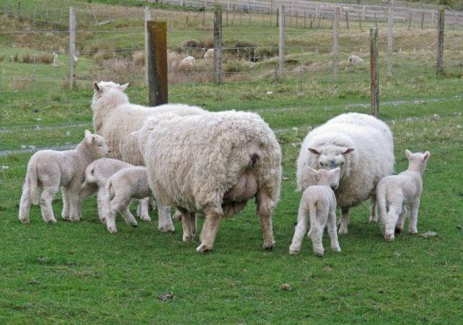
BREEDING SUPERIOR SHEEP
describe and explain how sheep breeders can achieve genetic progress in their flocks.

Slide 2
A sheep farmer can improve production by good management of the feeding, health and reproduction of a flock. Careful breeding improves a flock over a long time, because good production traits are selected for and passed on to the young over many generations.

Slide 3
Improving a flock by good breeding management involves:
• using superior rams
• recording performance
• culling low performers
• using high performing ewes for breeding
• keeping the best replacements from those high performing ewes.

Slide 4
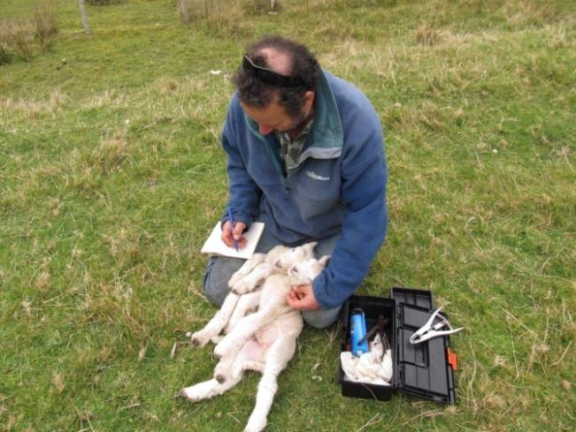
There are three types of sheep breeding farms, and they vary in the amount of performance recording that is done:
• stud farms
• performance recorded flocks
• commercial sheep farms.

Slide 5
Stud farm (sheep breeder)
All sheep are tagged to individually identify them.
Ewe to lamb links are carefully observed (to be certain of which lambs belong to which ewes).
Careful records of individual ancestry and performance must be kept.

Slide 6
Performance-recorded flocks.
All sheep are tagged to individually identify them.
Ewe to lamb links are usually carefully observed.
Careful records of individual ancestry and performance are kept as much as possible.

Slide 7
Commercial sheep farm…
Sheep are not permanently tagged to individually identify them.
Records may be kept of performance when meat or wool is harvested.

Slide 8
Genetic improvement is made by breeding sheep with better characteristics (traits). These characteristics may:
• improve production
• reduce costs (for example, because the sheep won’t need as much animal health treatment).

Slide 9
Use this table to answer the following questions…

Slide 10
1. Which traits would be of interest to a high country sheep farmer producing fine wool for clothing manufacture?

Slide 11
2. Some commercial sheep farmers use a terminal sire to produce lambs just for meat. What traits would be of interest to them in choosing their rams?

Slide 12
3. List the traits that would save money for all sheep farmers.

Slide 13
SHEEP BREEDERS AND STUD FARMS
Most commercial sheep farmers buy their rams from a stud farm. The sheep breeder on a stud farm produces superior rams for sale. Sheep in stud farms are tagged and their performance carefully recorded. Sheep breeders choose which traits to improve. Some aim to produce meaty sheep; others will be concentrating on wool traits, fertility or health traits, or a combination of traits. Newborn lambs are marked to link them with their dam.
In this photo, twin lambs have a spray marked number to identify their link with the ewe that is their mother. The breeder will have watched the sheep at, or soon after, the lambs were born. Fairly soon, the lambs will be given more permanent metal or plastic ear-tags.

Slide 14
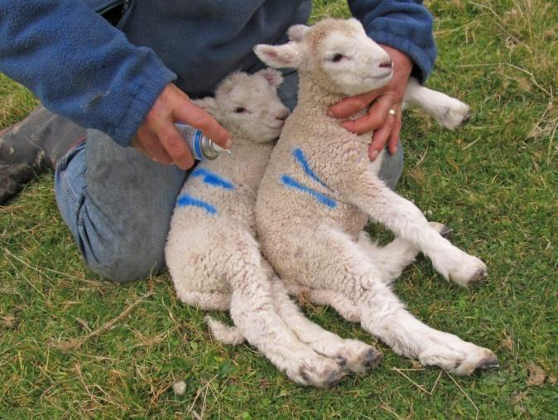
In this photo, twin lambs have a spray marked number to identify their link with the ewe that is their mother. The breeder will have watched the sheep at, or soon after, the lambs were born. Fairly soon, the lambs will be given more permanent metal or plastic ear-tags.

Slide 15
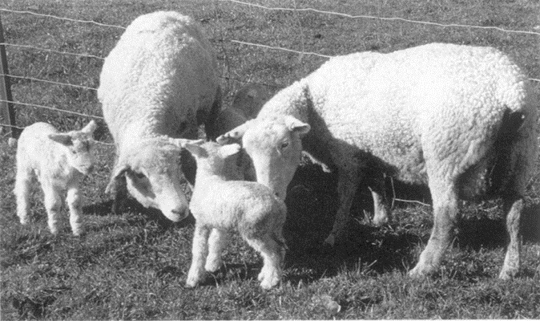
Sometimes the dam—to—lamb link is not clear. Some ewes can try to steal another ewe’s lambs.
In this case, the newborn lambs cannot be used for future breeding, as their parentage is not clear.

Slide 16
Depending on which traits the breeder is aiming to improve, the future growth and production is recorded, along with the identity of each animal’s sire and dam. Stud farmers improve the quality of their flocks by:
• keeping top-quality rams for breeding, or using semen from top-quality rams from New Zealand or overseas
• keeping top-quality ewes for breeding
• culling the low-producing animals
• keeping careful records of each animal’s production and parentage.

Slide 17
Improving traits..
Stud farmers usually choose one or two traits to improve. They then measure their animals to see which sheep are performing at a higher level. These sheep will be used for breeding, or be available for sale to commercial farmers.
Breeders have all sorts of ways to measure performance. Look at the following photos to see how different traits are measured.

Slide 18
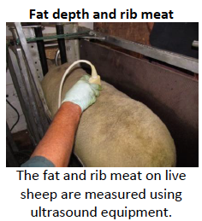
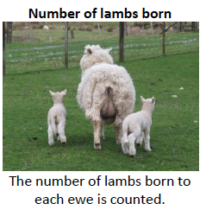

Slide 19
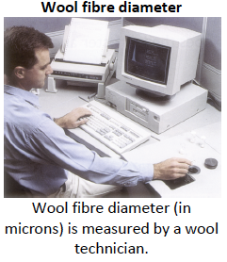
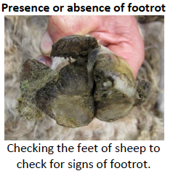

Slide 20
