Slide 1
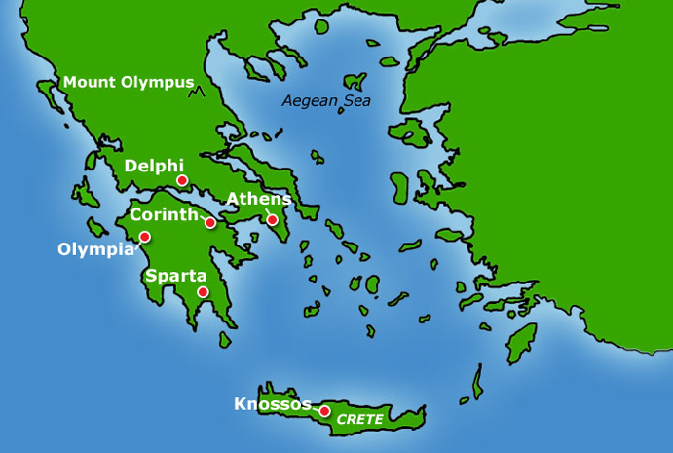
The Greeks…

Slide 2
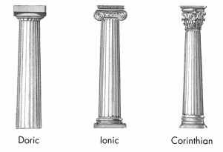
The Greeks…(before the Romans)
Collumns

Slide 3
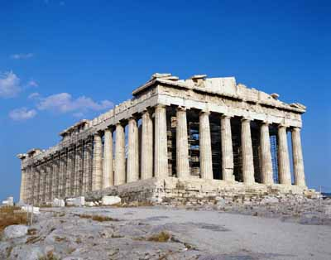
Temples…
Ie. The Acropolis

Slide 4
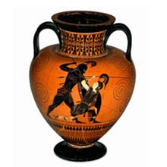
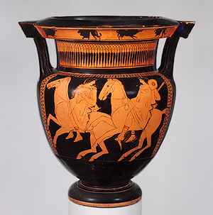
Vases

Slide 5
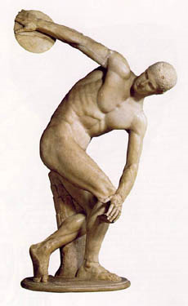
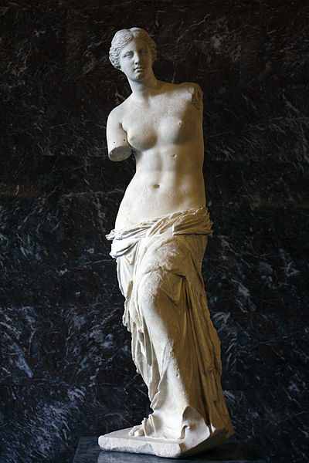
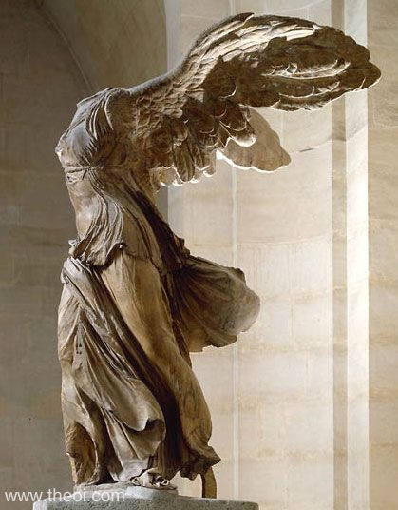
Sculptures…

Slide 6
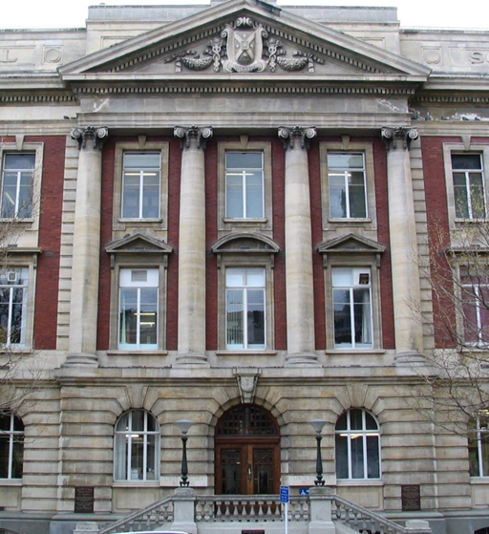
Today…

Slide 7
The Olympics
Law/ethics
Philosophy (Plato, Socrates, Aristotle)
Science/mathematics/astronomy
Myths, legends, gods
Stories

Slide 8
TASK….
Choose ONE aspect of Classical Greek Art (sculpture, architecture, vases), research it to find what it can tell us about the context of the Greeks…ie its society, culture at the time, stories, myths, ideas and philosophies, ideals etc. Whatever you can find really, but it MUST relate back to the artwork.

