Slide 1
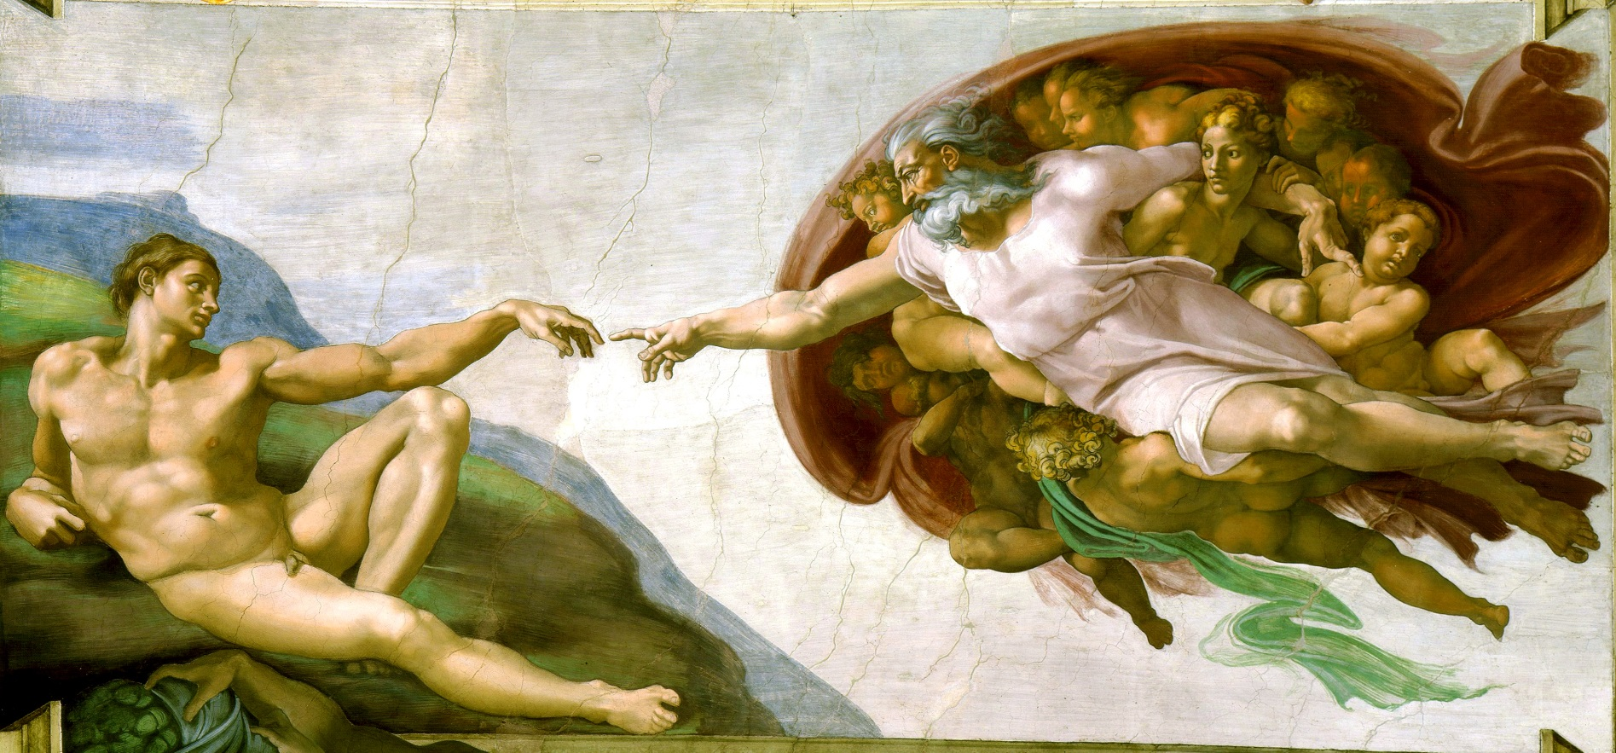
The Renaissance!!

Slide 2
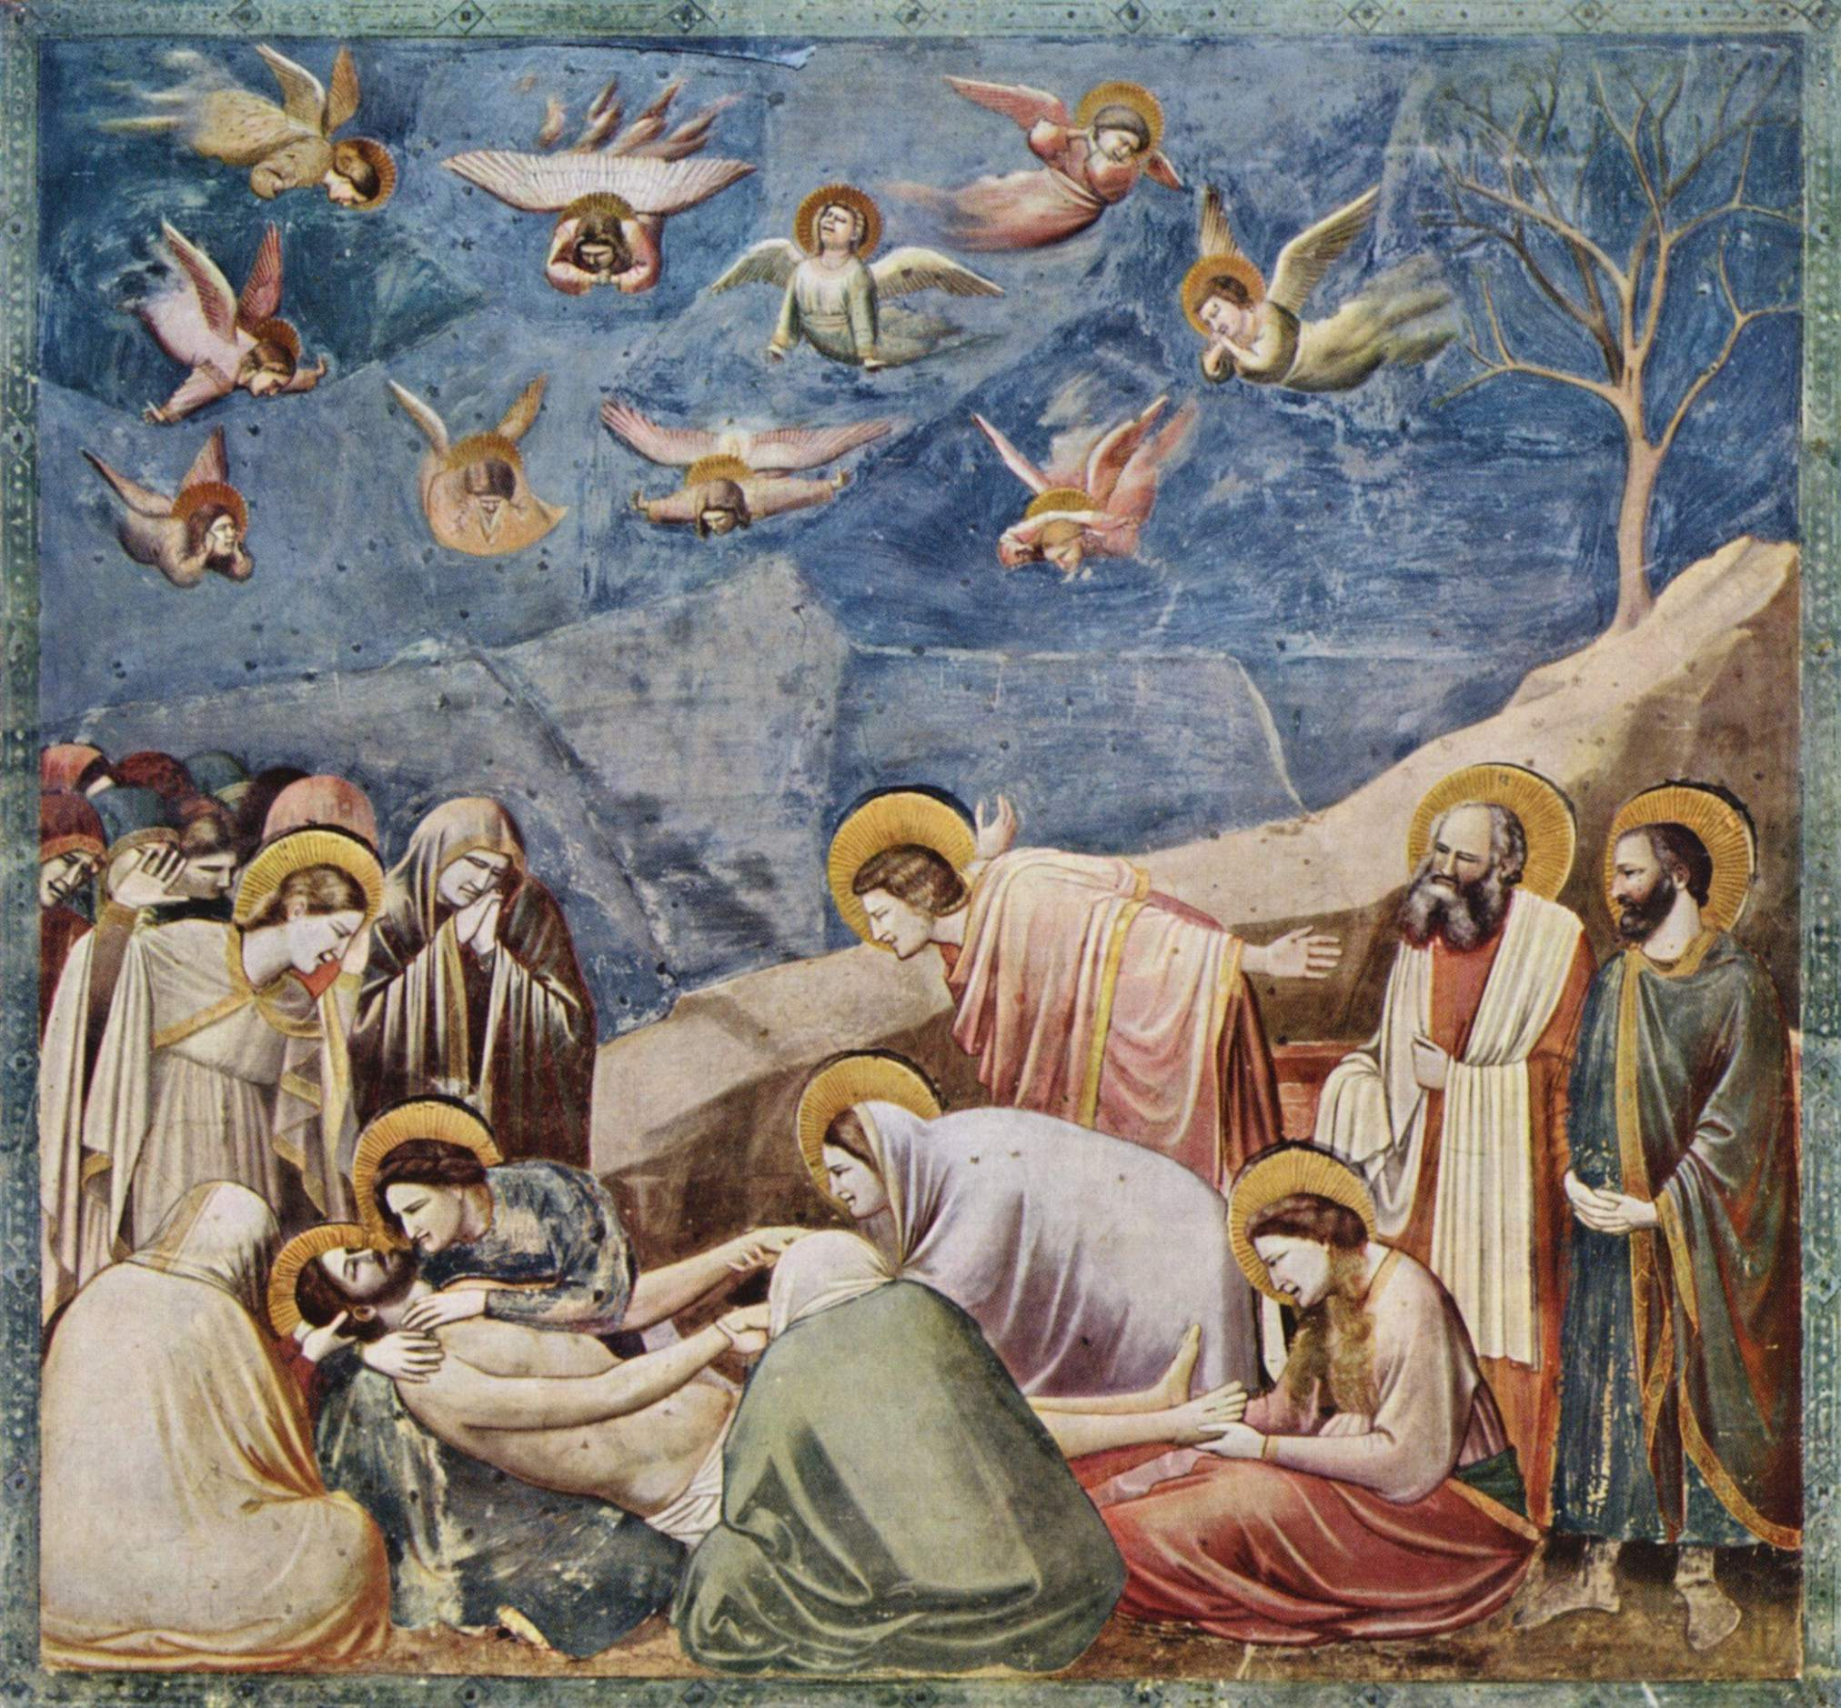
Giotto paved the way… 14th C.

Slide 3
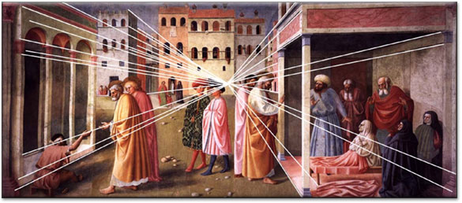
Perspective… Piero della Francesca 15th C.

Slide 4
The ‘high’ Renaissance.. 15/16th C.

Slide 5
Vasari
Alberti
Macchievelli
Dante
Galileo
Brunelleschi
Medici
City States
Merchant wealth
Italy
Papal States… church wealth and power
War/greed/corruption
Science

Slide 6
Donatello…

Slide 7
Michelangelo…

Slide 8
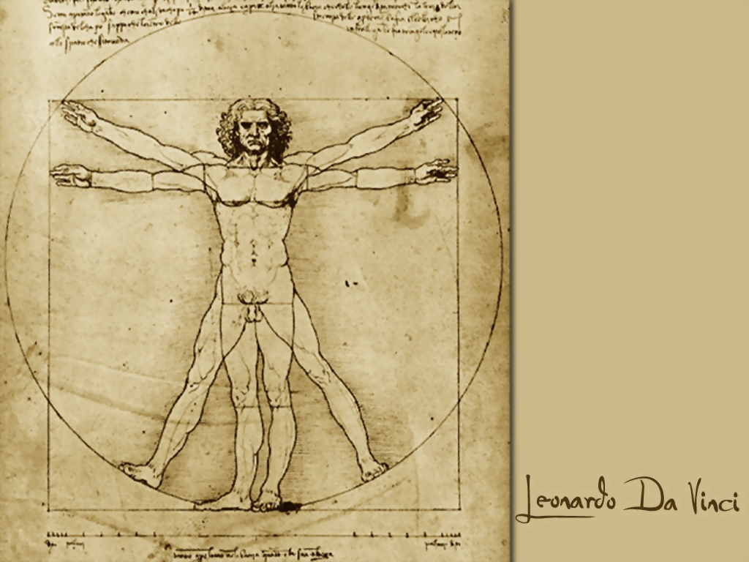
Leonardo… The Ultimate “Renaissance man”

Slide 9
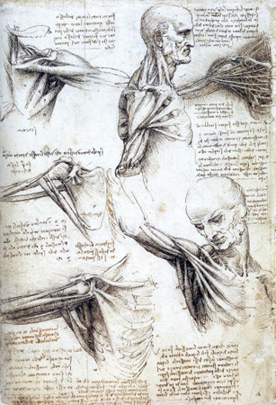

Slide 10
Galileo

Slide 11
Raphael…

Slide 12
“The school of Athens”

