Slide 1
Vaccinating…

Slide 2
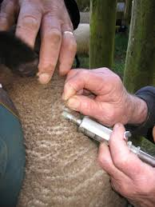
Cattle:
Calves should be vaccinated with the following programme:
5 In 1 sensitiser at 3 months old
5 in 1 booster at 4 months old
Sheep:
Sheep should receive an annual vaccination of 5 in 1 three weeks prior to lambing. This will protect both the ewe and the lamb, through the lambing risk period.
At docking lambs are susceptible to Pulpy Kidney and Tetanus and should therefore be vaccinated with Lamb Vaccine at this time to prevent sickness and death from these two diseases. Lamb Vaccine a special short acting vaccine designed for this purpose.
Lambs should then be vaccinated with the following programme:
5 In 1 sensitiser at 3 months old
5 in 1 booster at 4 months old

Slide 3
Vaccinating…
Vaccination is used mainly to prevent Colostridial diseases.
The common diseases are:
Pulpy kidney (PK, enterotoxaemia): Classical signs are sudden death in young lambs that are well fed and growing quickly. Can affect animals at any age, especially when they are grazing high quality pastures (eg flushing ewes, hoggets on spring pastures).
Tetanus: Occurs when tetanus spores enter deep wounds where there is minimal aeration and dead & damaged tissue. Most common after docking. Risk is greater with rubber rings and when the searing iron is not hot enough causing excessive deep tissue damage to allow the tetanus spores to proliferate.
The next 3 diseases are similar in appearance and all fall into the blood poisoning category which is typified by sudden death followed by going off quickly, bloody discharge from nose & bloating.
Blackleg: Usually associated with dirty wounds, grazing muddy winter feed crops, after lambing & using dirty vaccination needles.
Malignant oedema: Lesions very similar to blackleg.
Black disease: Usually associated with liver fluke infection.

Slide 4
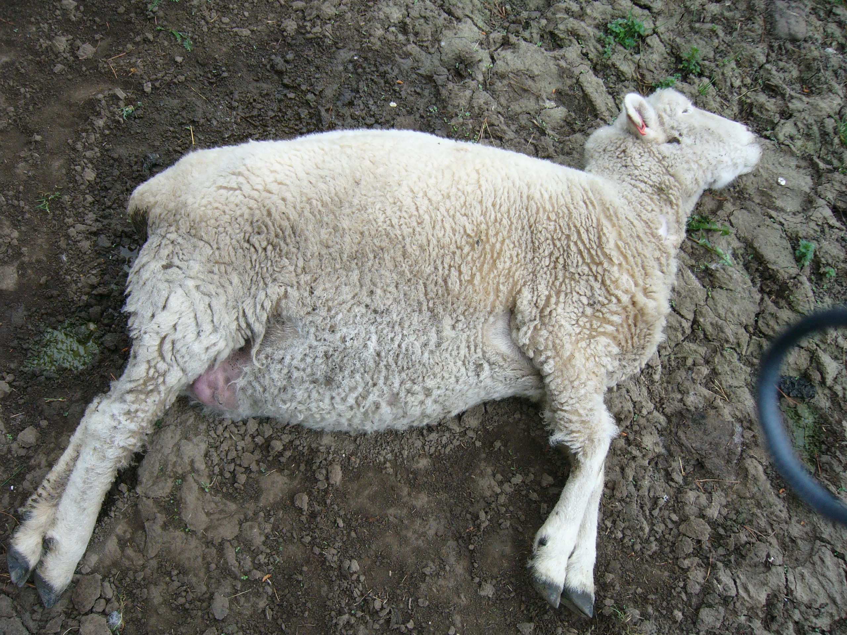
Signs and symptoms
Tetanus usually appears 10-14 days after the injury (e.g. docking wounds, shearing wounds). Animals are stiff and go into a rigid spasm if stimulated. They look as if they are smiling due to contraction of the facial muscles. Dead animals look normal.
Pulpy Kidney usually only found dead with no outward signs. Post mortem may help, but no vaccination, lambs doing very well & very sudden death are classical.
Blood poisoning usually found dead. “Go off” very quickly. May be gas under the skin.

Slide 5
The impact…
All the common clostridial bacteria are almost endemic throughout NZ farms, however the diseases are relatively uncommon due to the widespread use of vaccination. Because vaccination is so effective and has been around for a long time many new generation farmers may never have seen the diseases.

Slide 6
Farmers need to be confident that the disease risk will always be present and that a sound vaccination programme will be stopping the disease from happening. Most of the disease outbreaks are now associated with farmers forgetting to vaccinate.
The cost of a 5-in-1 vaccine is approx 12 cents per dose, or 24 cents to fully protect a lamb. Over 1000 lambs the cost is $240 so the programme only needs to save 3 lambs at $80

Slide 7
What is this lamb suffering from?

Slide 8
Scabby Mouth…
What Is Scabby Mouth Disease And How Is It Spread?
Scabby mouth is a viral disease affecting sheep of all ages. The virus enters sheep through damaged skin generally caused by contact with thistles, hay, coarse pastures and stubbles. Feedlot environments and the use of pelleted feed will also predispose to the virus development. The most common form of disease spread is via a previously infected animal. The virus can survive in the wool and on the skin of these animals for a long time. The movement of animals from property to property has had a major impact on the disease spread throughout New Zealand.
The disease is extremely efficient at gaining entry into the animal; all sheep are potential targets. Lambs are the group of sheep most at risk. The scabby mouth disease cycle is approximately 4 to 5 weeks for completion. During this time there are a number of stages up and until the scabs fall off.

Slide 9
The virus can survive in the environment for many years under ideal conditions. Shearing sheds, watering points, feed troughs and sheep yards are the most common places for sheep to become infected with the virus.
Clinical signs of the disease may vary within age group of sheep. Scabs appearing on the mouth and lips are particularly common in lambs. The nostrils, teats and udders, the poll of rams and the feet are the other commonly affected areas.

Slide 10
What Effect Does Scabby Mouth Disease Have?
The lesions resulting from infection although only temporary can severely restrict the growth rate of lambs with obvious financial penalties resulting. Repeated failure to prevent scabby mouth disease in lambs could also be considered an animal welfare issue and result in action being taken by the authorities.

Slide 11
If you want to know more about S.M….
http://www.cluthavets.co.nz/animal-health/204-sheep-scabby-mouth-faq.html

Slide 12
How to vaccinate…
TASK:
Use the “vaccinating Blog” on Clarkiescourses to create a step-by-step summary of hiow you should correctly vaccinate. (Should include at least 10 of the main steps).

